Slide 1
Virtual Stakeholder meeting

Slide 2
Programme

Slide 3
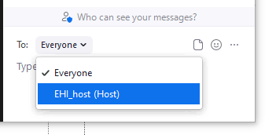
housekeeping
Got questions?
Slides are available on request
Drop in/out as you need
Emergency Procedures?
Each segment will have ~5 min dedicated Q&A time. You can submit questions via chat (to EHI_host) at any time, or verbally during the Q&A
Got a question?
Message EHI_host

Slide 4
Introduction to EHINZ
Prof. Barry Borman

Slide 5
HAZARDOUS SUBSTANCES SURVEILLANCE SYSTEM
Liam Kelly & Shunnie Xie

Slide 6
Content
1.The current state
2.Changes in the HSDIRT tool
3. Future plans
HAZARDOUS SUBSTANCES SURVEILLANCE SYSTEM (HSSS)

Slide 7
The current state
Fatal injuries
NZ Mortality Collection, National Coronial Information System
National Minimum Dataset
Injuries requiring hospitalisation, emergency
Treatment, or resulting in disability
Exposures reported to National Poisons Centre
Hazardous Substances Disease and Injury Reporting tool (HSDIRT)
Injuries resulting in primary care treatment
Calls to the National Poisons Centre
Injuries that do not receive attention in a health institution
HAZARDOUS SUBSTANCES SURVEILLANCE SYSTEM (HSSS)

Slide 8

PART TWO
Changes in the HSDIRT tool
HAZARDOUS SUBSTANCES DISEASE & INJURY REPORTING TOOL (HSDIRT)

Slide 9
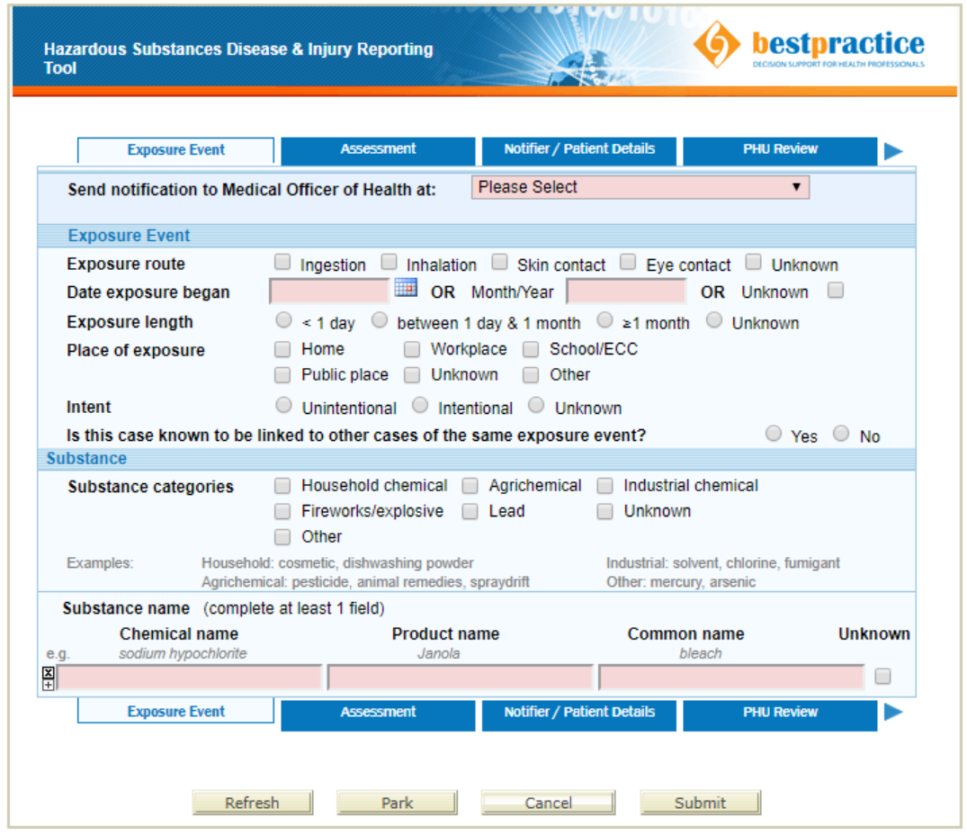
Changes in the HSDIRT tool
Shifted from generic logins to individual logins.
Incorporating StatsNZ classification of occupation into HSDIRT.
To make HSDIRT system interoperable with direct laboratory notifications.
HAZARDOUS SUBSTANCES DISEASE & INJURY REPORTING TOOL (HSDIRT)

Slide 10
PART THREE
Future plans
HAZARDOUS SUBSTANCES SURVEILLANCE SYSTEM (HSSS)

Slide 11



Future plans
Investigating use of ACC data to understand duration of harm and cost analysis of hazardous substances.
How NPC and NZ Fire & Emergency can be linked to GP notifications, hospitalisations and mortality.
How IDI data sets can be used to assess risk and long-term impacts
Increasing accessability and useability of HSDIRT for GP's.
HAZARDOUS SUBSTANCES SURVEILLANCE SYSTEM (HSSS)

Slide 12
Contact us if you have any questions
0800 588 265
s.xie@massey.ac.nz
lkelly1@massey.ac.nz
www.ehinz.ac.nz
HAZARDOUS SUBSTANCES DISEASE & INJURY REPORTING TOOL (HSDIRT)

Slide 13
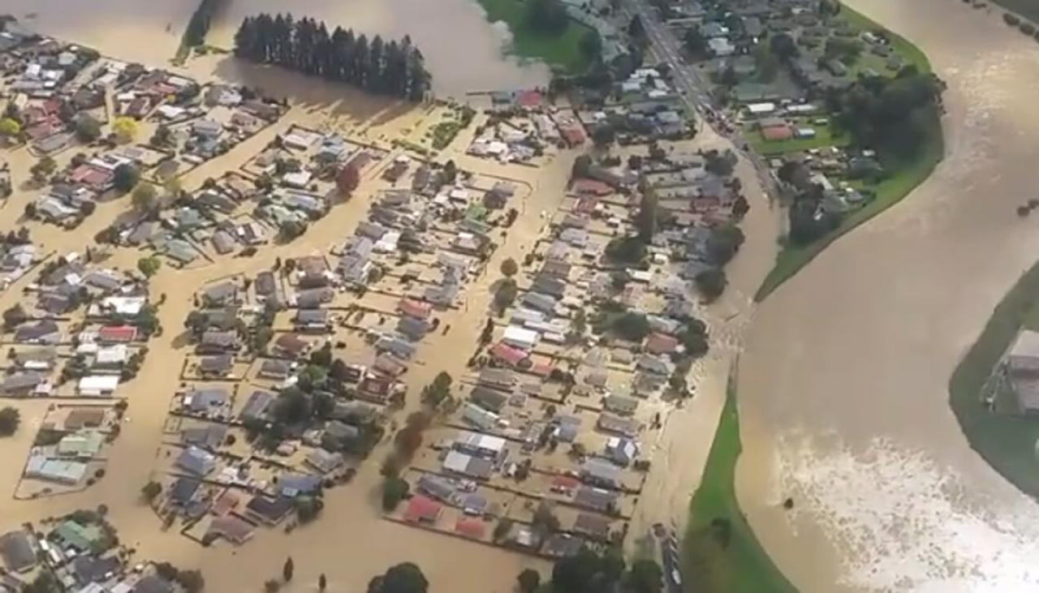
Social vulnerability indicators and population vulnerability
Kylie Mason
Edgecumbe floods, NZ, March 2017

Slide 14
Social vulnerability to natural hazards
Social vulnerability to natural hazards:
  characteristics that influence people’s capacity to anticipate, cope with, and recover from natural hazards
Social vulnerability to natural hazards relates to people’s:
  exposure
  susceptibility
  lack of resilience
We have developed a set of social vulnerability indicators for New Zealand for 2018 (SVI2018)

Slide 15
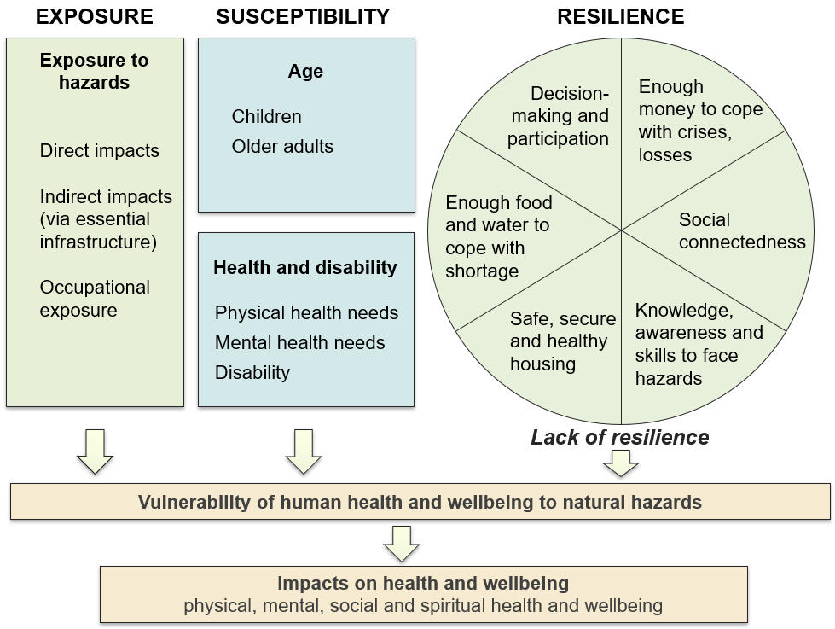
Conceptual framework

Slide 16
Indicator list
Dimension | Indicators (with Census-type data for NZ)
Exposure | Usually resident population Number of households Urban/rural classification Ethnic group (total response): European, Māori, Pacific peoples, Asian, MELAA
Exposure (occupational) | Health care and social assistance workers Primary industry workers
Children | Children aged 0–4 years Children aged 0–14 years School-aged children (5–14 years) Households with at least one child aged 0–4 years Households with at least one child aged 0–14 years
Older adults | People aged 65+ years People aged 75+ years People aged 85+ years People aged 70+ years Households with an older adult (65+ years) living alone
Health and disability | Pregnant women (proxy)
Dimension | Indicators (with Census-type data for NZ)
Having enough money to cope with crises/losses | Socioeconomic deprivation (NZDep2018 decile) Unemployed people People who are not in the labour force Single parent households Households with no access to a car
Social connectedness | Households living in rental housing One-person households Recent immigrants (less than 1 year; 0-1 years)
Knowledge, skills and awareness to face hazards | People who do not speak English Households with no access to a mobile phone Households with no access to the internet
Safe, secure and healthy housing | Crowded households People living in crowded households Damp dwellings (always; always or sometimes) Mouldy dwellings (always; always or sometimes)
Enough food and water to survive | Households living in rental housing Socioeconomic deprivation (NZDep2018 decile) Dwellings with no access to safe drinking water Dwellings with no access to fridge Dwellings with no electricity
Decision-making and leadership | Voter turnout in 2019 Local Authority Elections

Slide 17
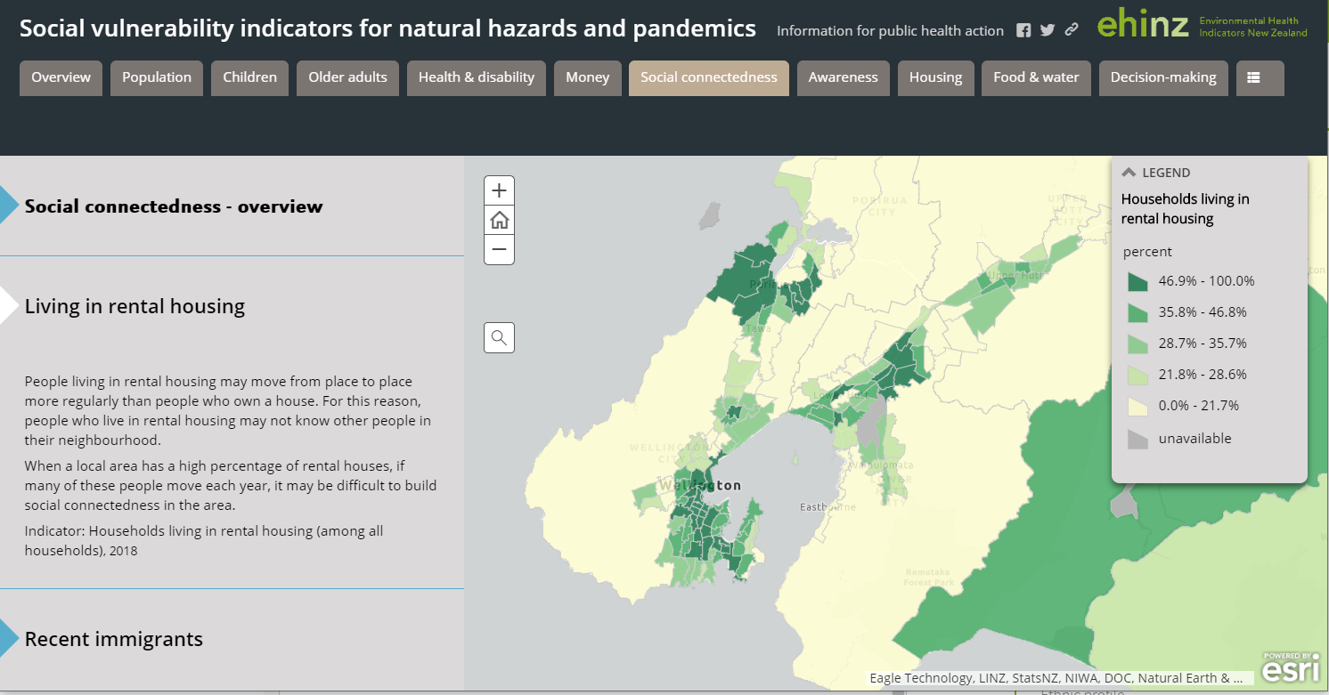
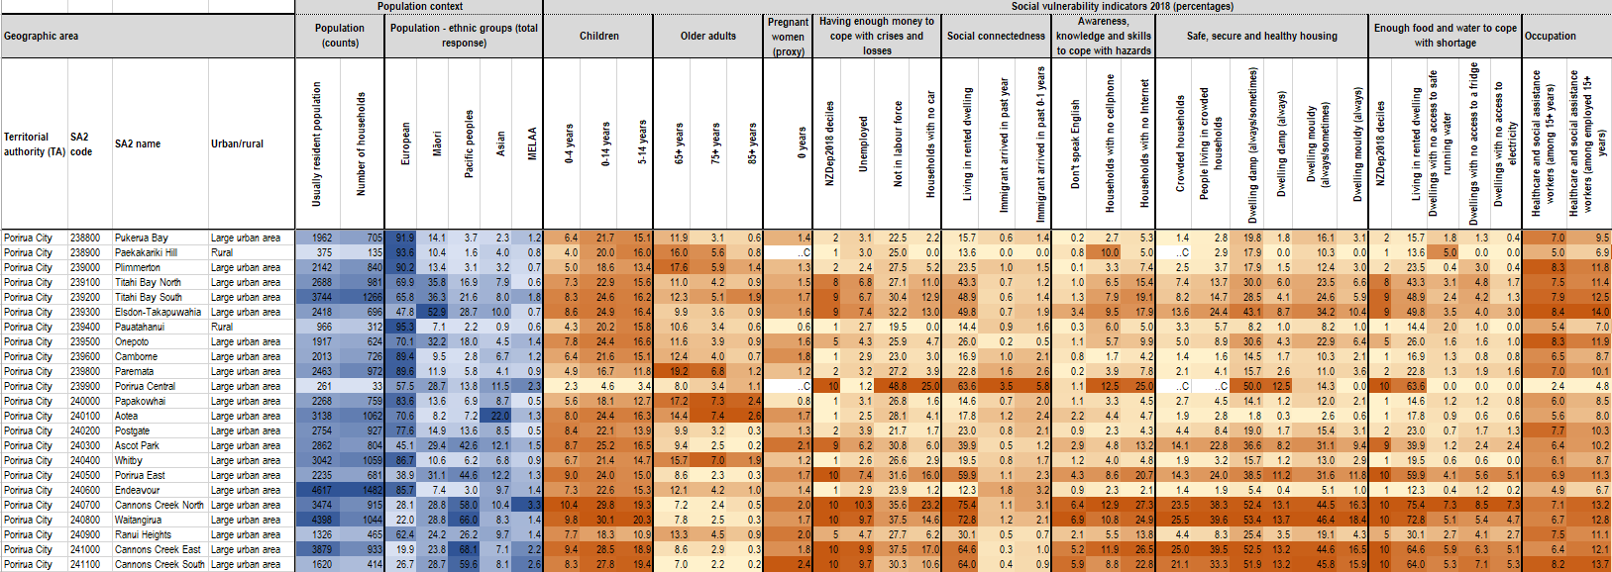
Visualising the indicators
  Indicator data is available at SA2, TA, DHB, Auckland local board area levels
  Data is available in Excel spreadsheets
  Data now available as REST service for ArcGISOnline

Slide 18
Future work
Developing health indicators, eg
  People with cardiovascular disease, respiratory disease, diabetes, mental health conditions
Factsheets about health effects from different natural hazards, and who is most vulnerable to these – eg, earthquakes, tsunami, volcanoes, floods, wildfires, heat waves
Identifying useful social vulnerability indicators for environmental hazards – eg air pollution
Overlay social vulnerability indicators and natural hazards, environmental hazards
  Are more vulnerable populations more exposed to environmental hazards and/or natural hazards in New Zealand?

Slide 19
Social vulnerability indicators
www.ehinz.ac.nz
EHI website  Population vulnerability  Social vulnerability indicators
www.ehinz.ac.nz/indicators/population-vulnerability/
social-vulnerability-to-natural-hazards/
For more information, please contact me:
Kylie Mason
k.mason@massey.ac.nz
Acknowledgements: Kirstin Lindberg, Carolin Haenfling, Allan Schori, Helene Marsters, Patrick Hipgrave, Barry Borman, Deborah Read (Massey University); James Beban, Sarah Gunnell (Urban Edge Planning Ltd); Rawiri Faulkner (Tūtaiao Ltd); Kristie-Lee Thomas (GNS Science); Ben Popovich (NIWA)

Slide 20
Data visualisation
Environmental Health indicators are presented on interactive dashboards and reports (Regional reports for Alcohol related-harm domain)
Environmental Health dashboards with regional data are embedded on Healthspace.
Domain specific dashboards, e.g., Water quality, are embedded on EHI website.

Slide 21
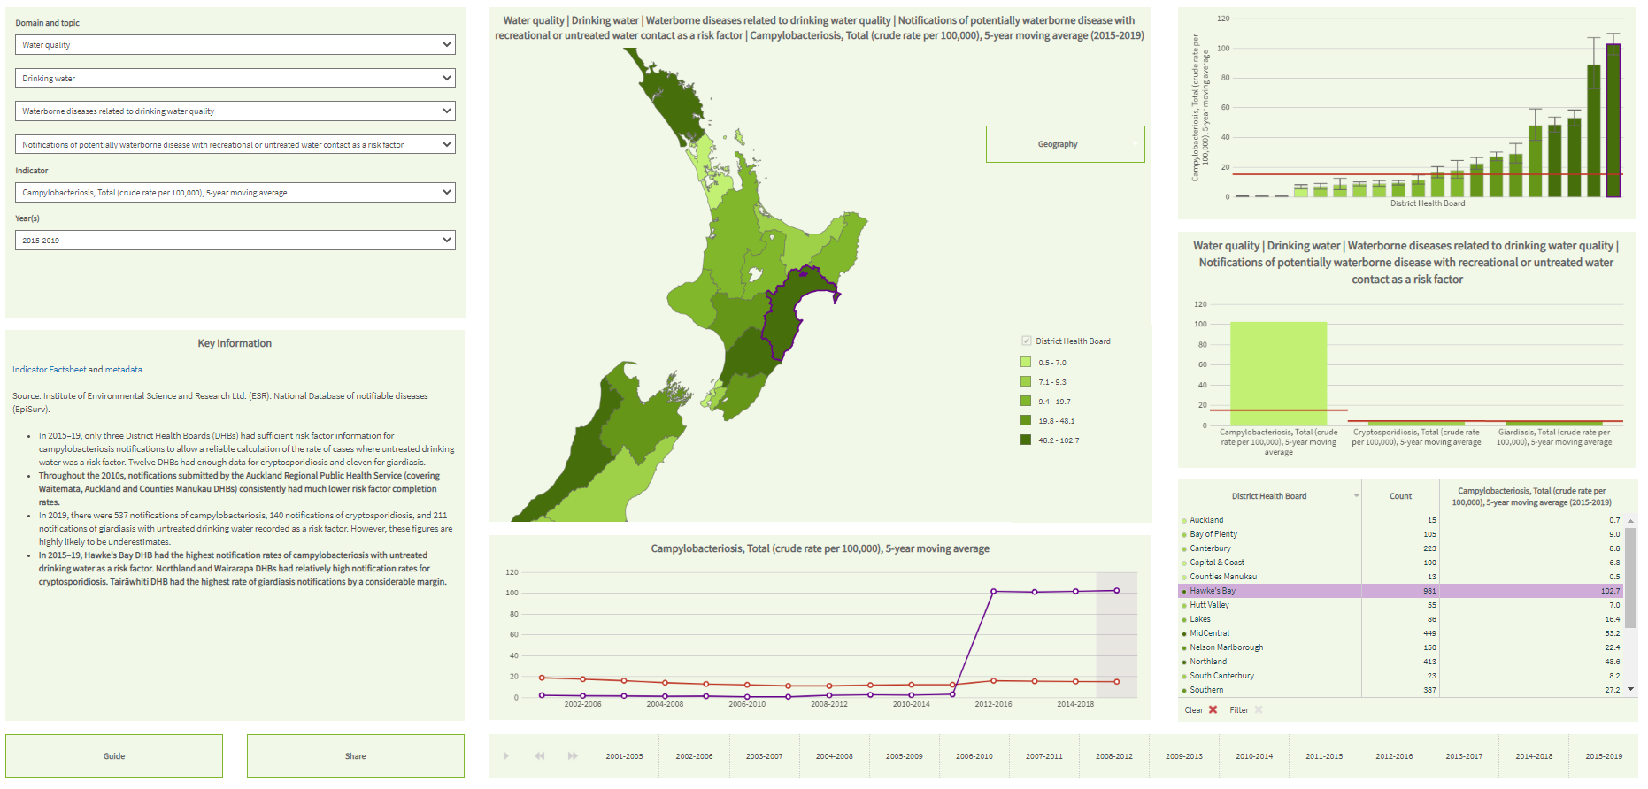
Data visualisation

Slide 22
Data visualiSation – WHAT’S NEW
We are developing online factsheets.
They will have the same look and feel as PDFs but will be interactive.
  Tool tips provide users with indicator information (i.e., values, confidence intervals) when mousing over chart elements.
  Allow users to download individual factsheet components (i.e., charts, tables, data).
  Retain the ability for users to download factsheets as pdf.

Slide 23
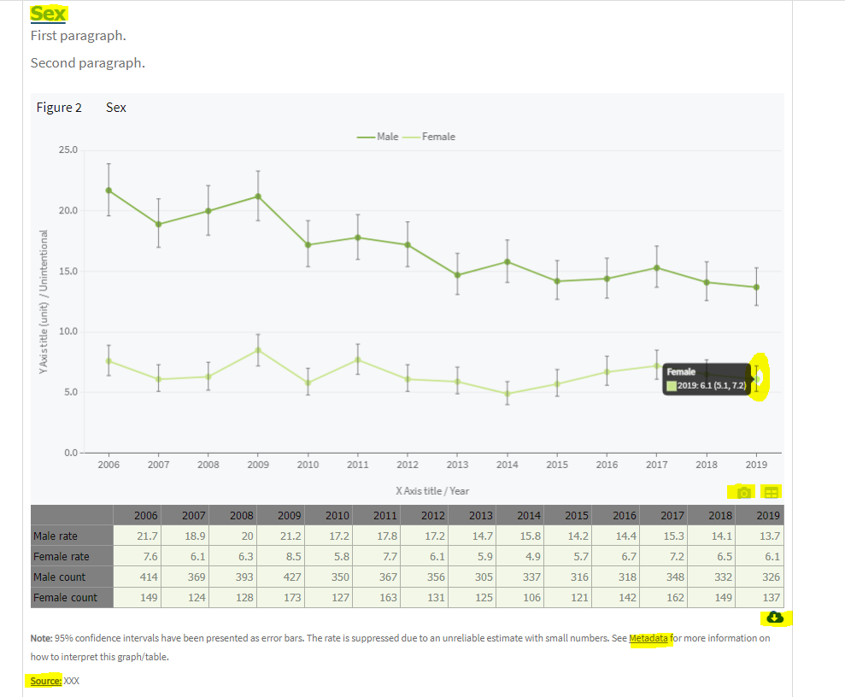
Data visualiSation – WHAT’S NEW

Slide 24
Data visualiSation – WHAT’S NEW
So far, we have done:
  two trials
  designed templates
  developed process workflow
  began work on first factsheets.

Slide 25
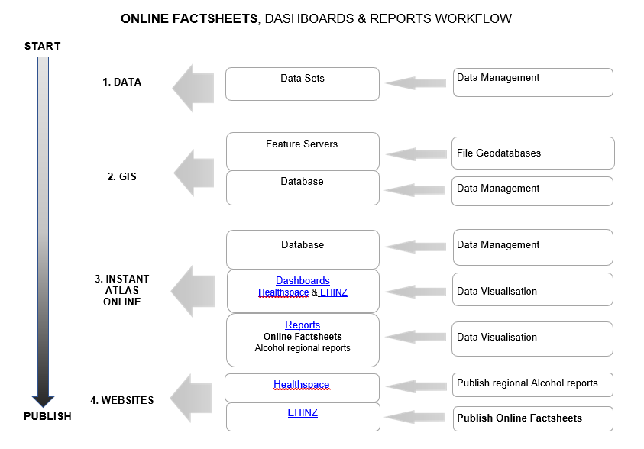
Data visualiSation – WHAT’S NEW

Slide 26
Data visualiSation – WHAT’S NEW
The next stage will involve phased replacements of PDFs over the next couple of years.
Questions - He Patai?

Slide 27
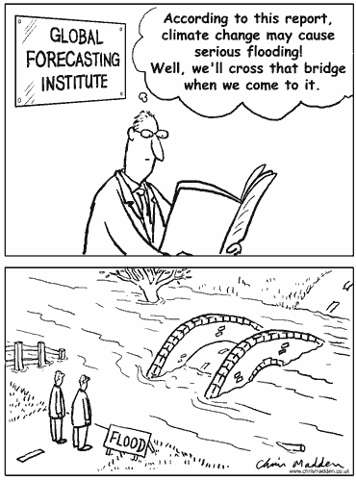
Climate change
Carolin Haenfling
c.haenfling@massey.ac.nz

Slide 28
Indicators
TEMPERATURE
Number of days below 0°C
Number of days above 25°C
HEALTH EFFECTS
Notifications of salmonellosis
Notifications of cryptosporidiosis and giardiasis
RAINFALL AND DROUGHT
Number of days in soil moisture deficit
Number of days with extreme rainfall
Annual average amount of rainfall
ENERGY
Total energy consumed, by fuel type and sector
Climate change

Slide 29
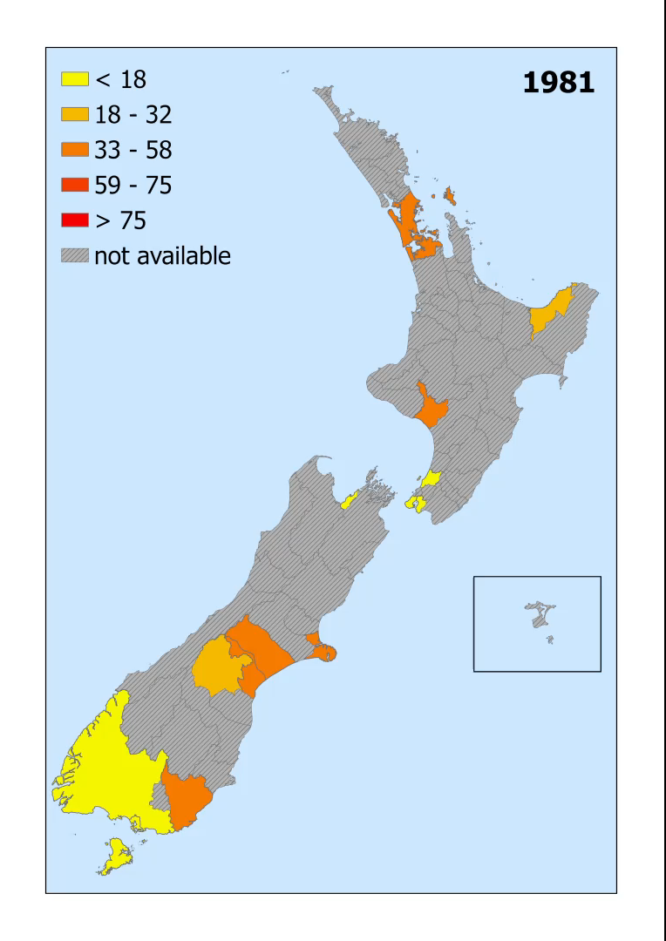
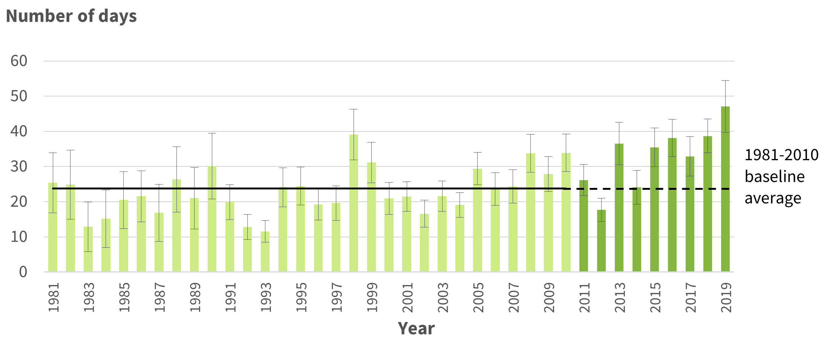
Extreme temperatures
Climate change

Slide 30
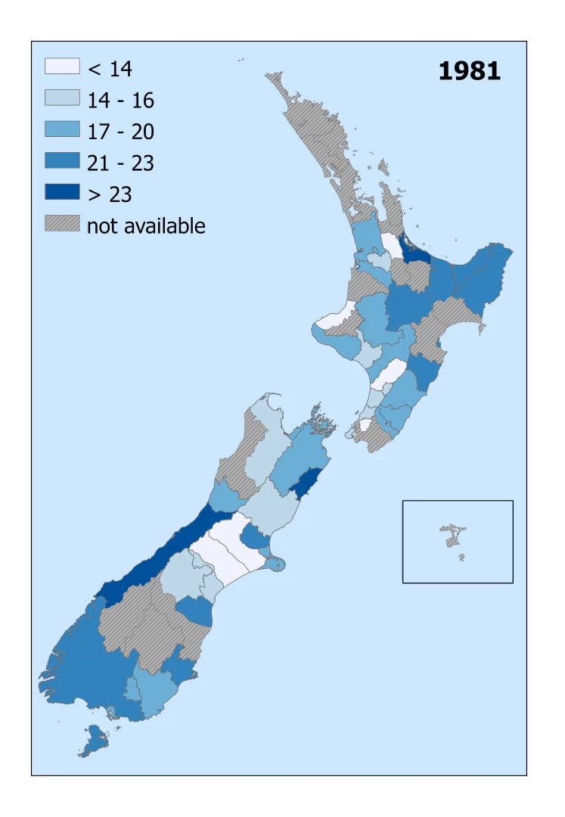
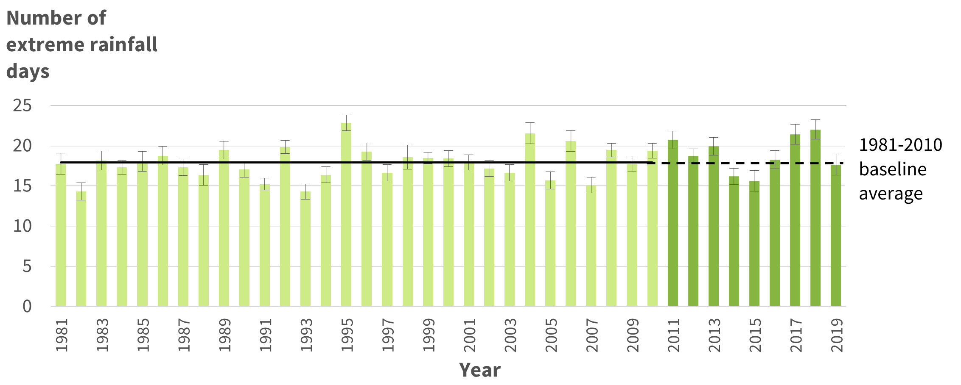
Rainfall and Drought
Climate change

Slide 31
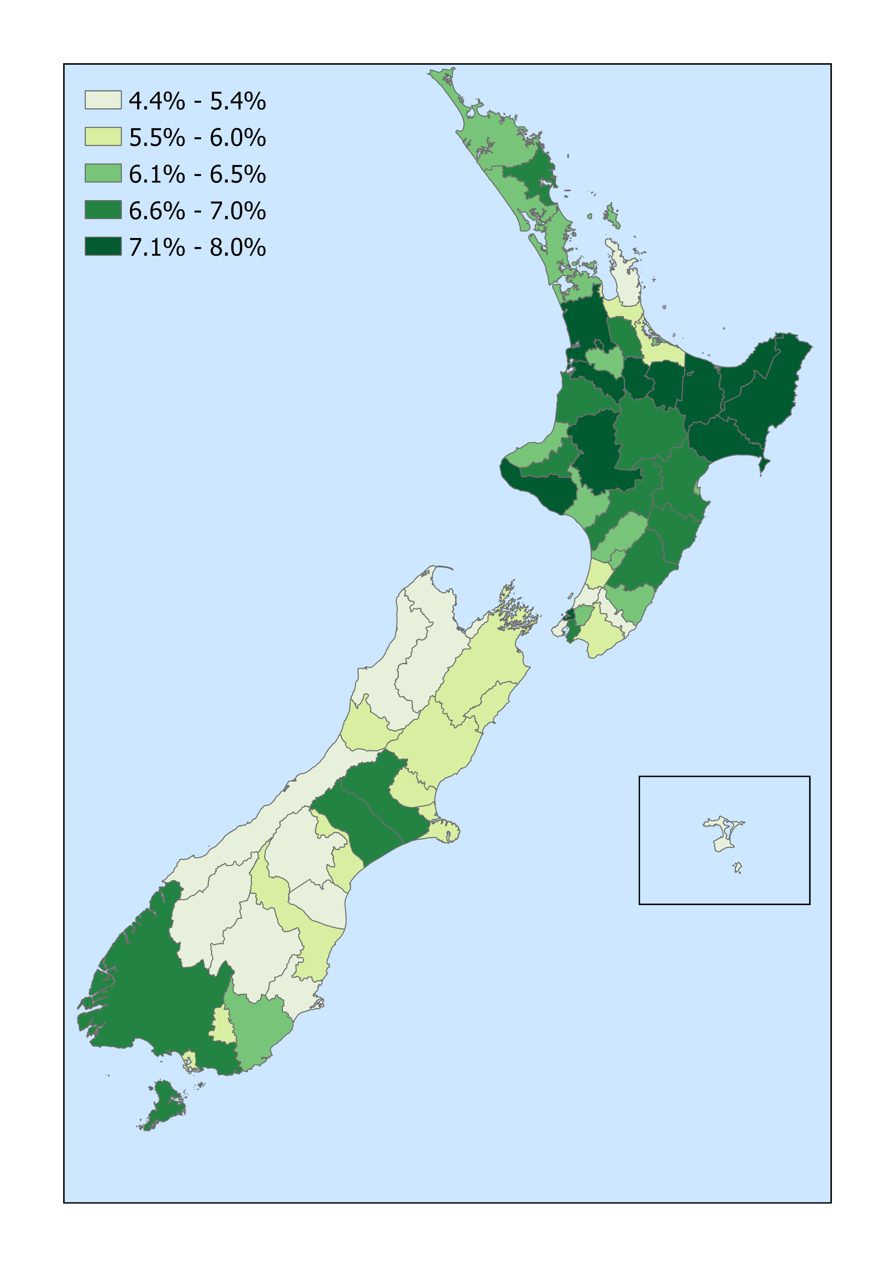
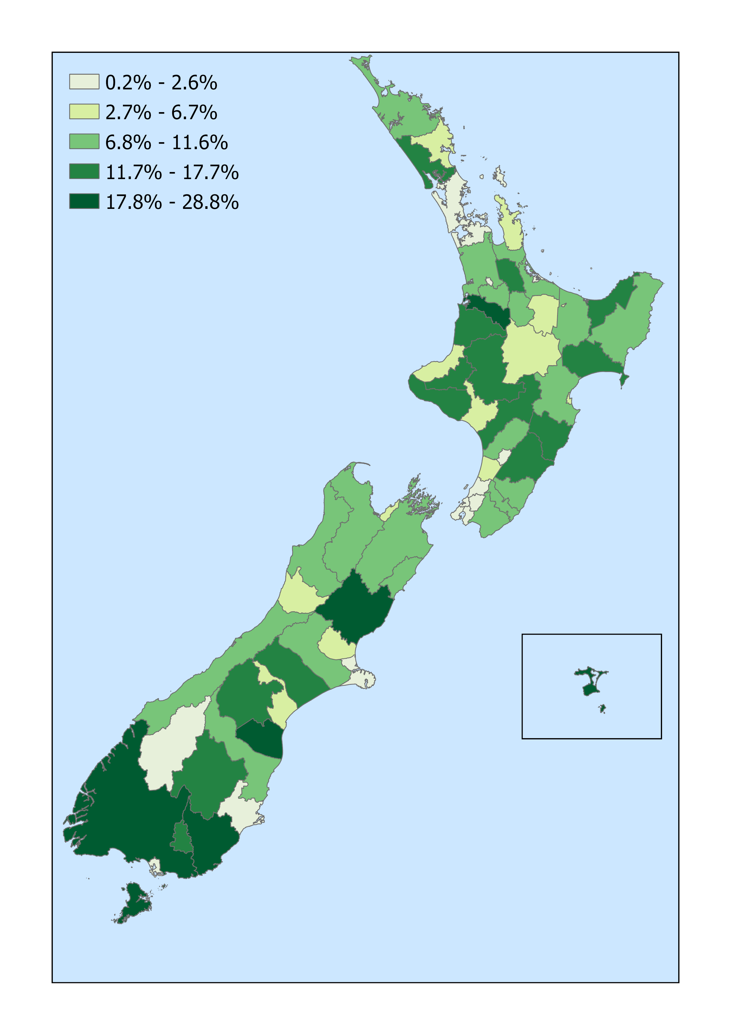
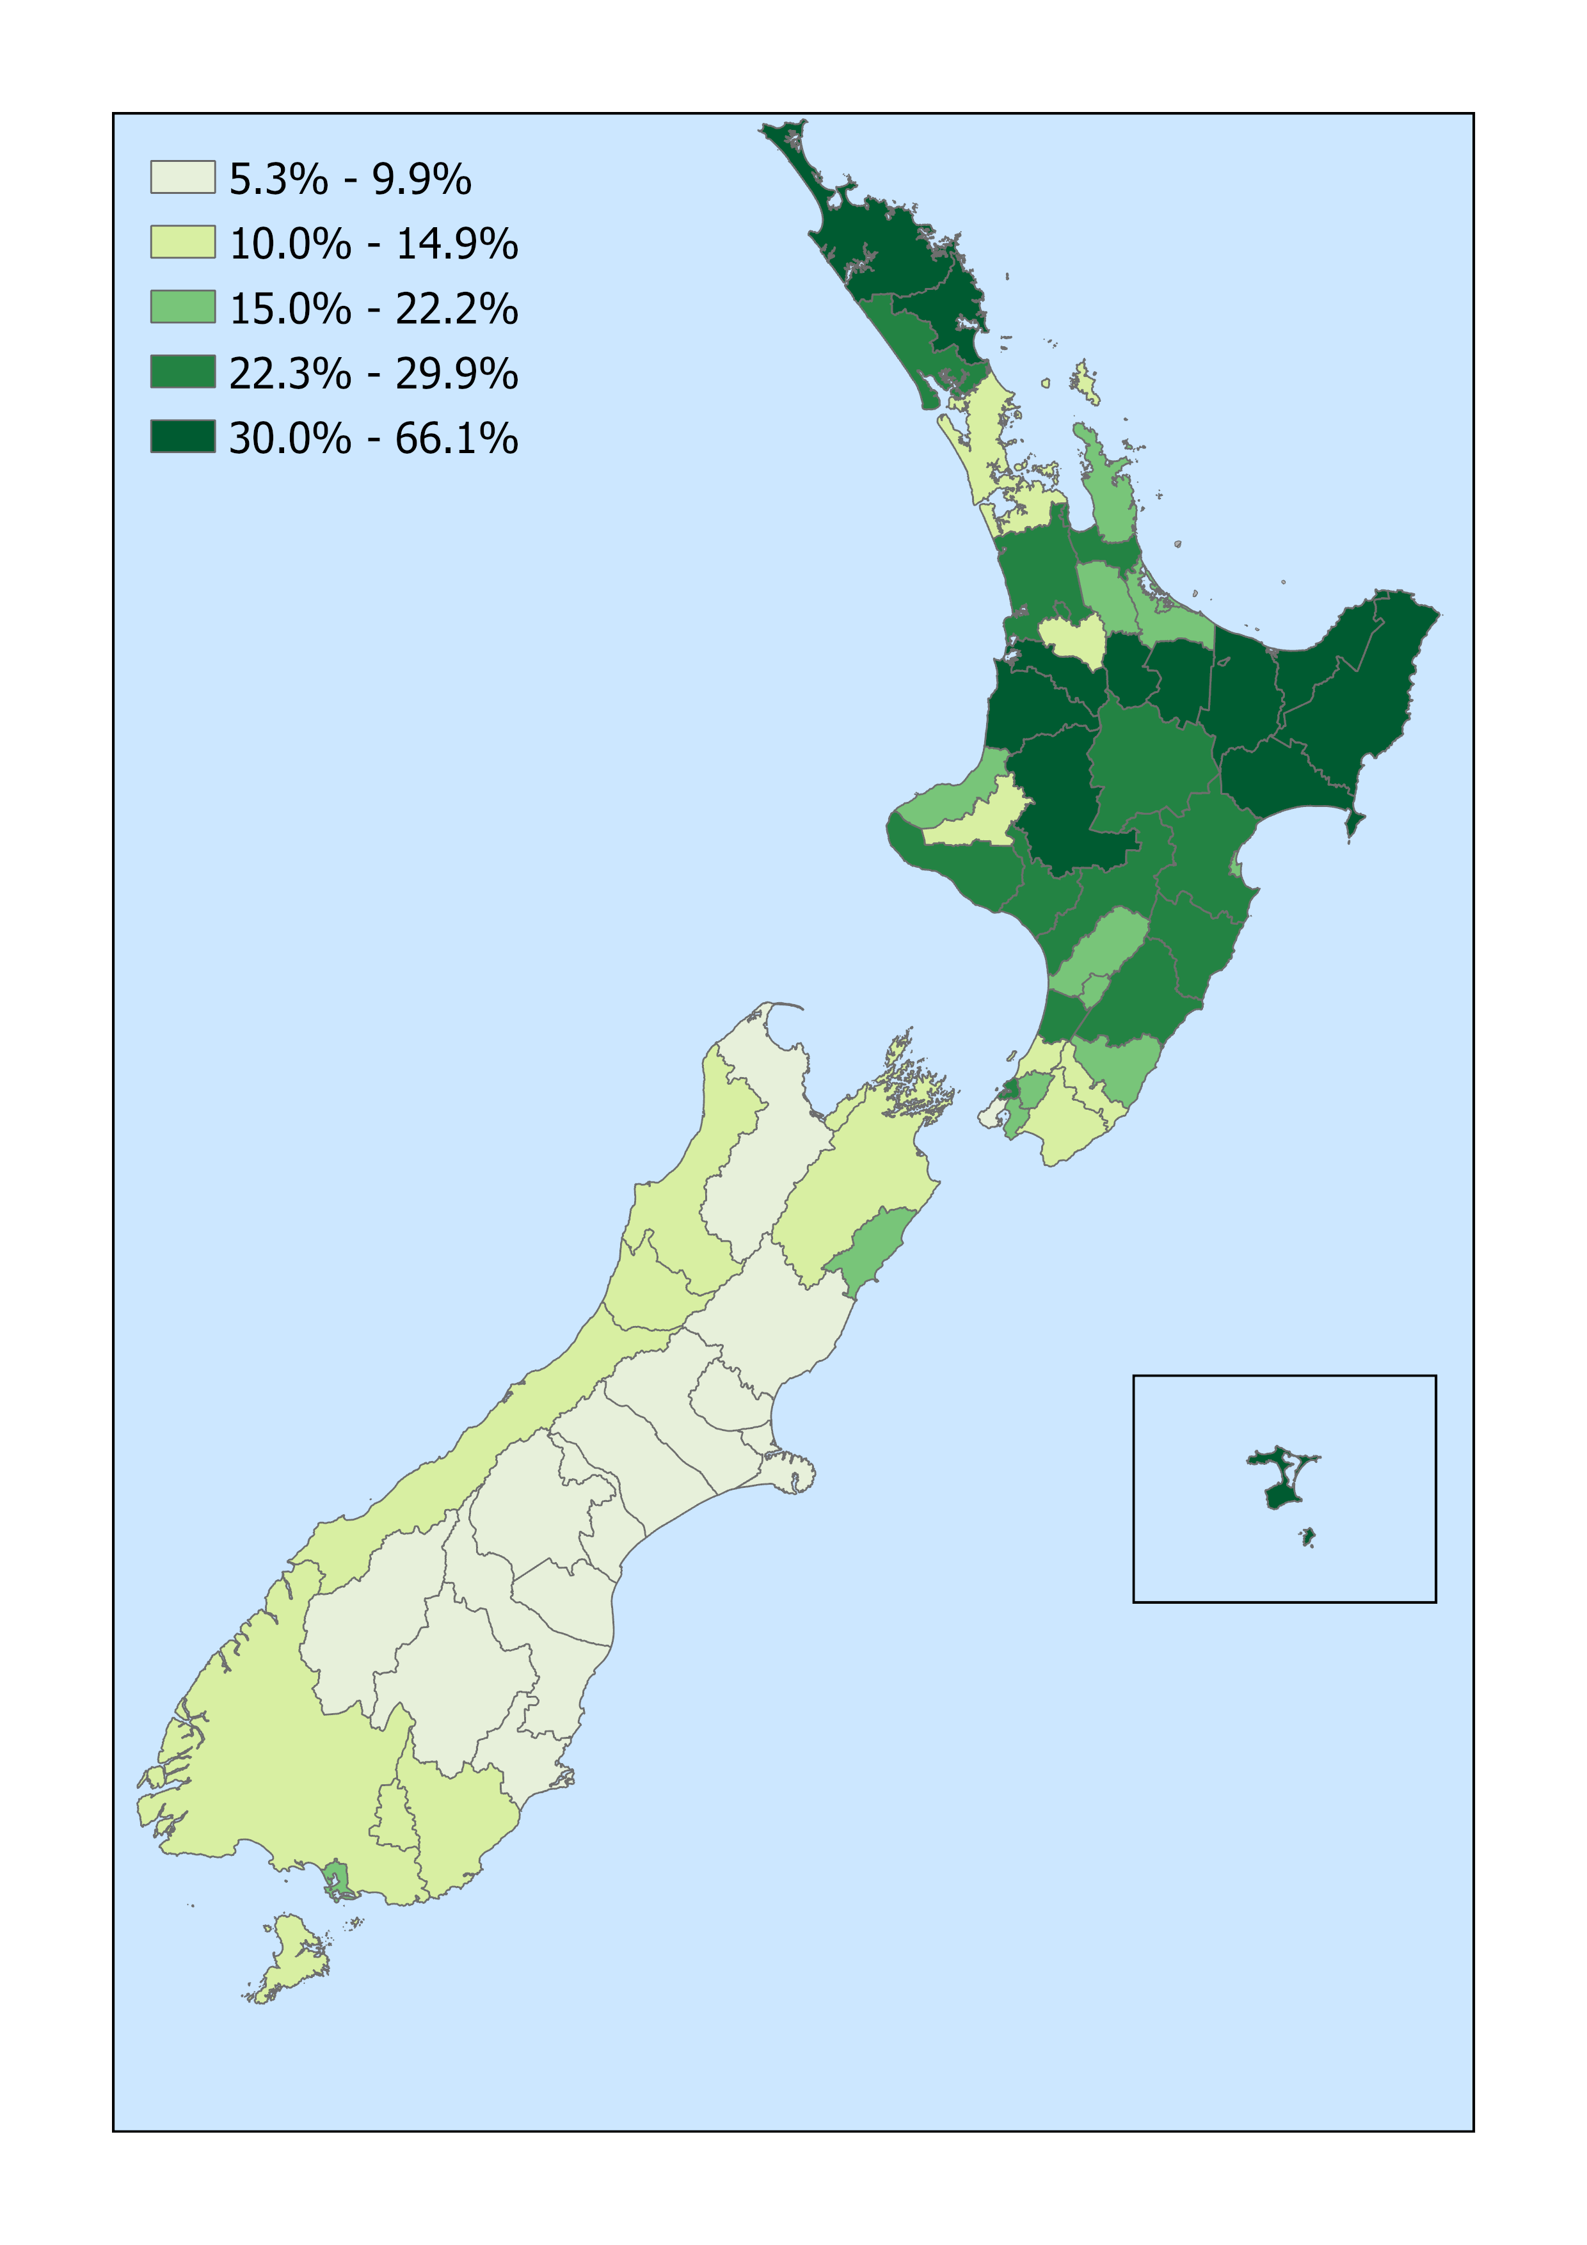


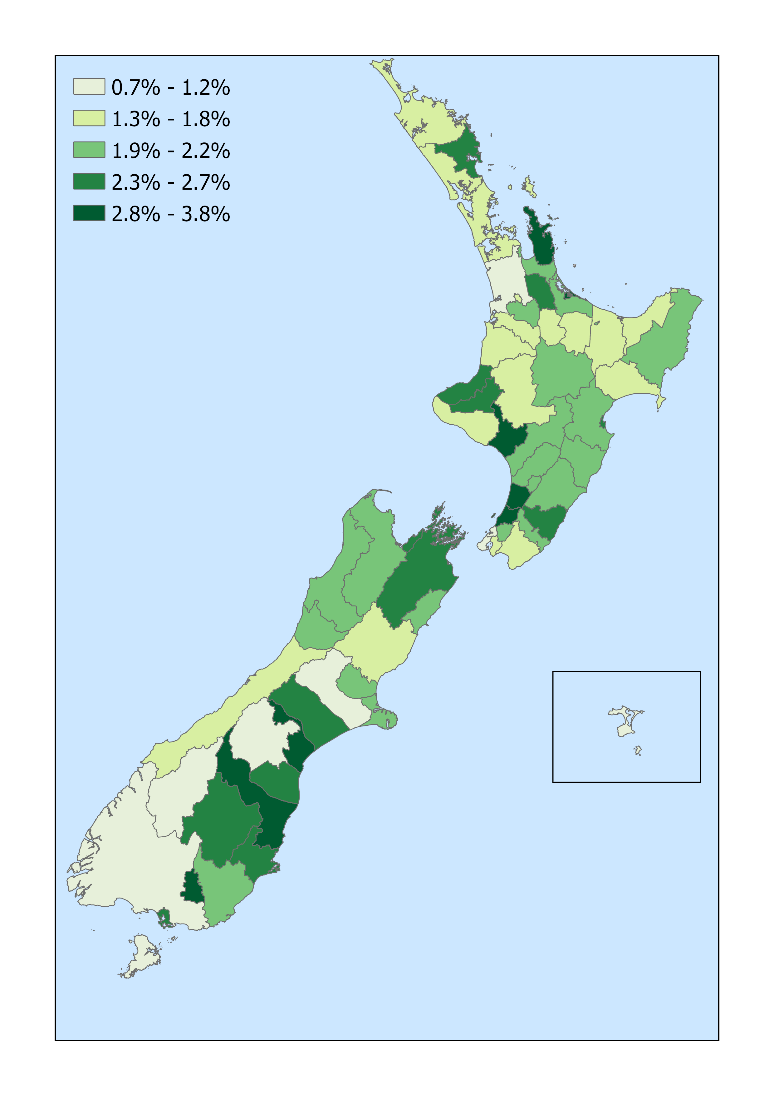
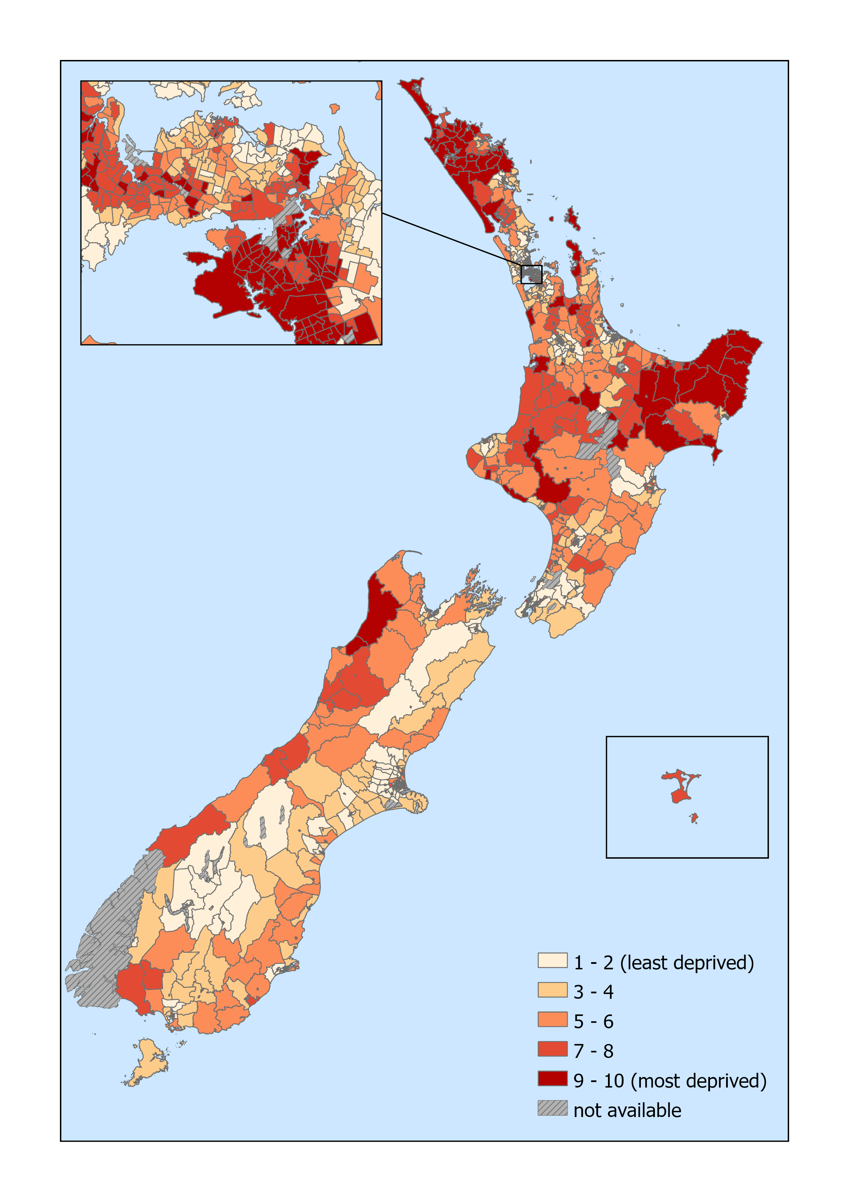


Vulnerability
capability
exposure
sensitivity
Māori
Climate change

Slide 32

Future work
TEMPERATURE
Air Quality
HEALTH EFFECTS
Water Quality
RAINFALL AND DROUGHT
vulnerability
Border Health
ENERGY
Climate change
Notes:
-

Slide 33
Air quality
Carolin Haenfling
c.haenfling@massey.ac.nz

Slide 34





indicators
HEATING
MOTOR VEHICLES
OTHER AIR POLLUTANTS
Main types of heating used to heat dwellings
Number of motor vehicles in the fleet, by vehicle type and fuel type
Number of motor vehicle registrations, by vehicle type and fuel type
Average age of vehicle fleet
Monitoring sites exceeding the WHO annual average guideline for nitrogen dioxide
Monitoring sites exceeding the national environmental standard (one-hour average) for nitrogen dioxide
Monitoring sites exceeding the WHO daily guideline for sulphur dioxide
Monitoring sites exceeding the national environmental standard (one-hour average) for sulphur dioxide
Monitoring sites exceeding the national environmental standard (eight-hour rolling average) for carbon monoxide
Monitoring sites exceeding the WHO one-hour average guideline for carbon monoxide
HEALTH EFFECTS OF AIR POLLUTION
PARTICULATE MATTER
Estimated number of restricted activity days associated with air pollution
Estimated number of cardiac and respiratory hospital admissions associated with air pollution
Estimated number of premature deaths associated with air pollution
Monitoring sites exceeding the WHO annual average guideline for PM₁₀
Monitoring sites exceeding the national environmental standard (24-hour average) for PM₁₀
Monitoring sites exceeding the WHO daily guideline for PM_{2.5}
Monitoring sites exceeding the WHO annual average guideline for PM_{2.5}
Air quality

Slide 35
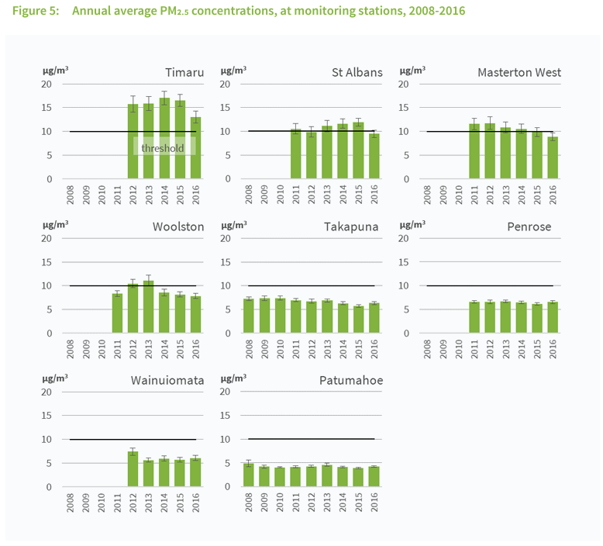
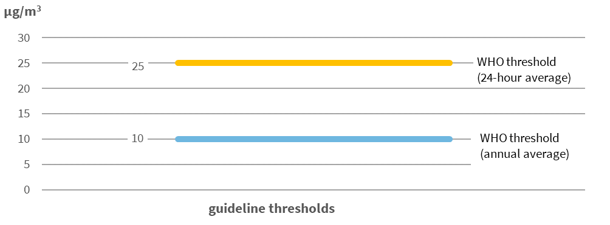
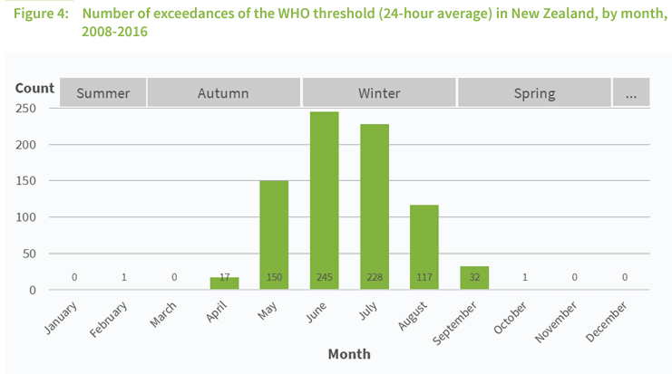
pM_{2.5}
Air quality

Slide 36
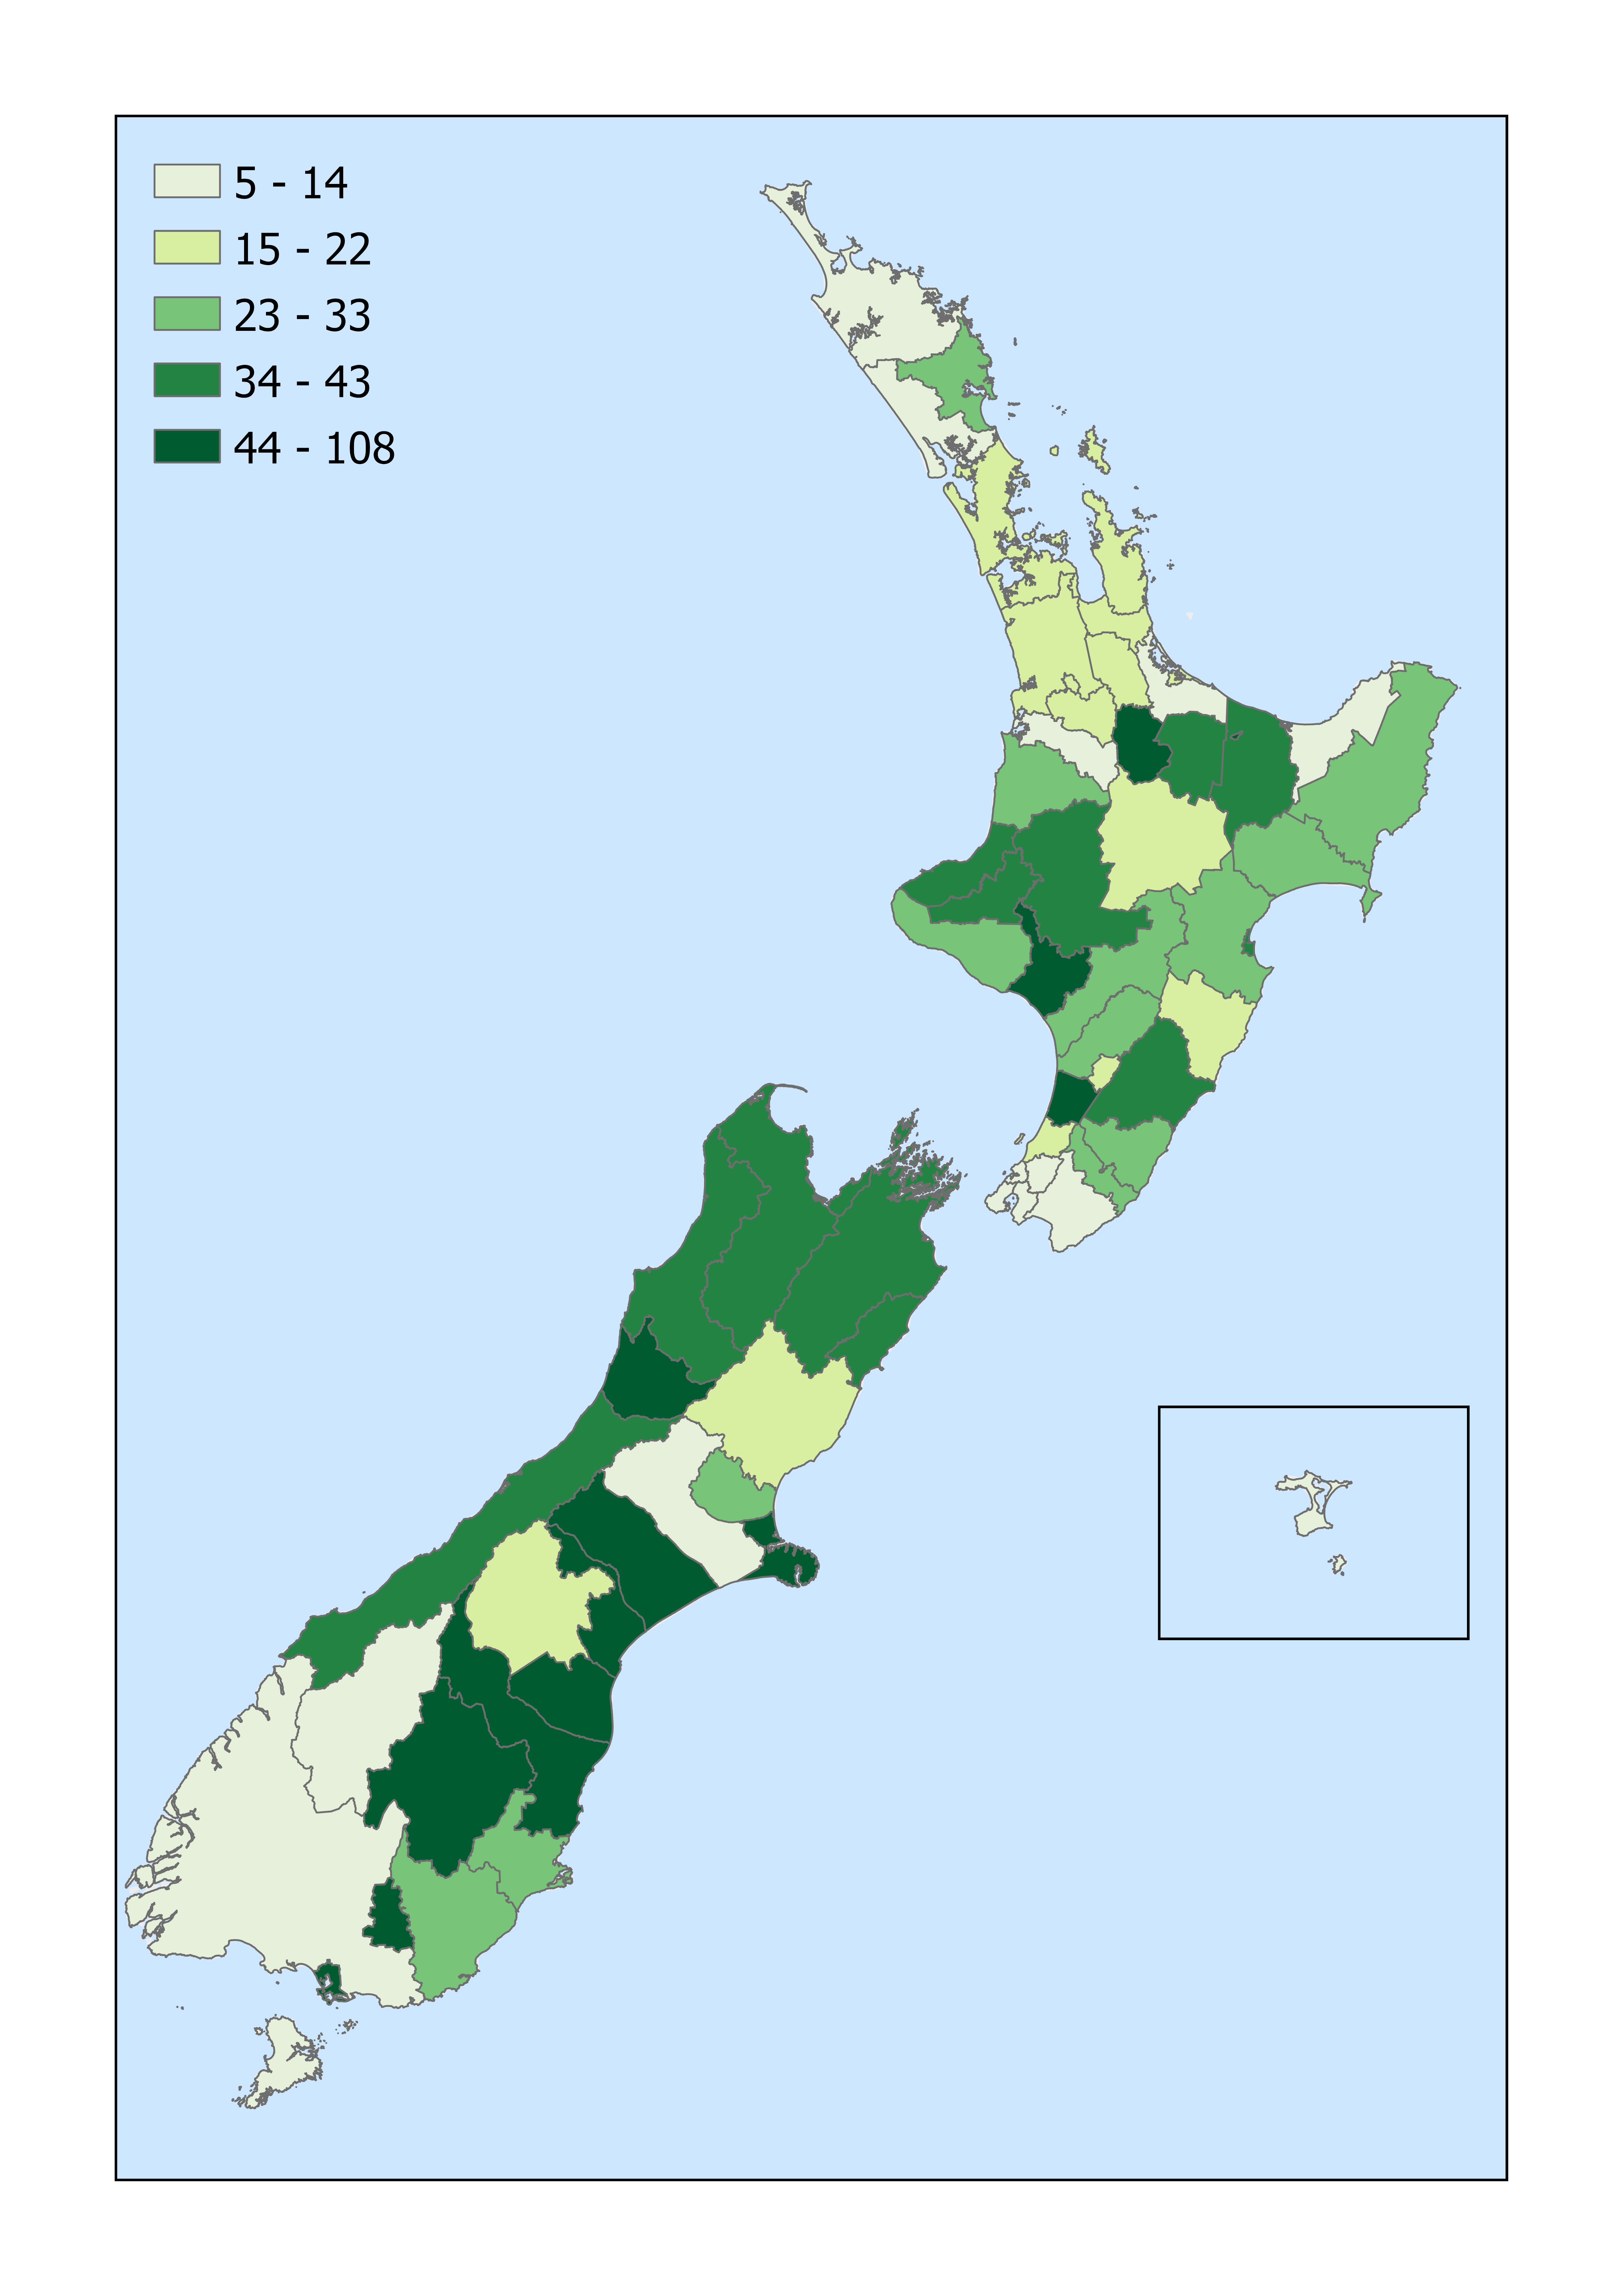
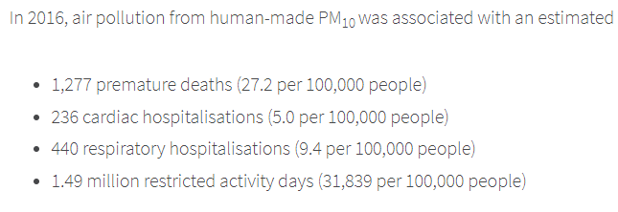
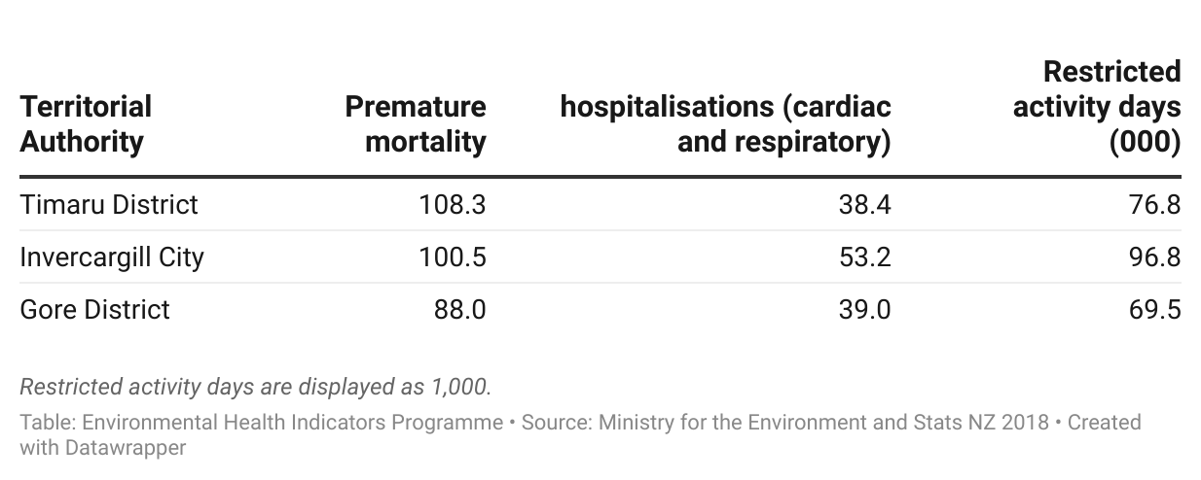
Health effects
Air quality

Slide 37
Future work
Impact of Clean Car Discount on electric vehicle registrations
Update air pollutant data and compare to latest WHO air quality guidelines
Update health effects of air pollution data with latest HAPINZ results
15
5
Air quality

Slide 38
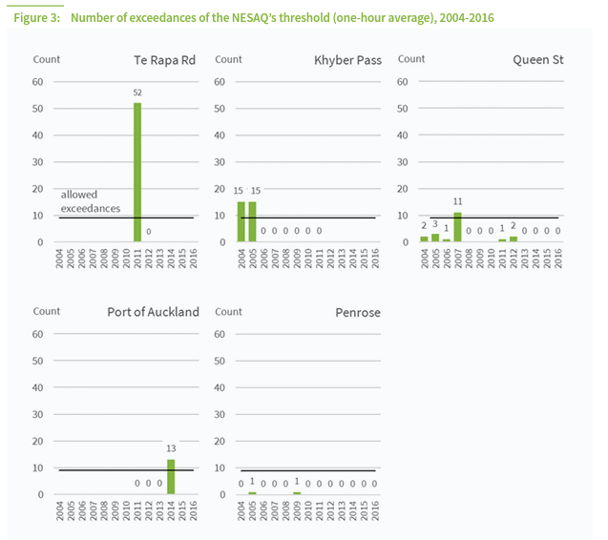
Future work
Air quality during COVID-19 lockdown
Air quality

Slide 39

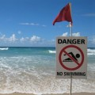

Water quality
Patrick Hipgrave

Slide 40
Indicators
Access to safe drinking water | Number of people served by water supplies that met bacteriological, chemical and protozoal standards
Access to fluoridated drinking water | Number of people served by fluoridated water supplies
Oral health of children | Number of children free of dental caries Mean number of decayed, missing or filled teeth per child
Waterborne diseases | Notifications of Cryptosporidiosis, Campylobacteriosis and Giardiasis Overall with drinking/recreational water as a risk factor
Agricultural activity | Number and density of livestock Area of agricultural land Area of irrigated land
Suitability for swimming | Concentrations of Faecal indicator bacteria at recreational bathing sites
Short description section
  Body copy.
    Note
Bullet points
Bullet point

Slide 41
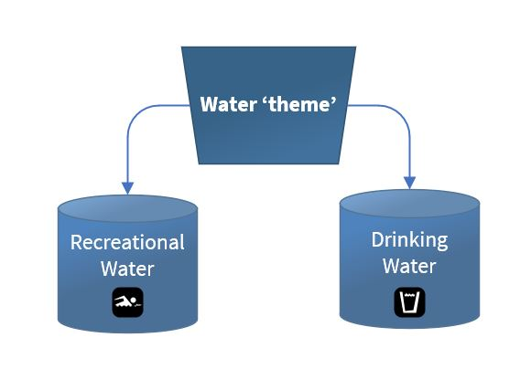
What’s new?
Recreational water + Drinking water quality
=
‘Water’
Anticipating new govt. frameworks for water quality
Change is to how existing topics are presented, rather than content
Water is the ‘theme’, Rec/Drinking water are still the domains
Existing indicators unchanged
Space for expansion into other areas e.g. wastewater

Slide 42
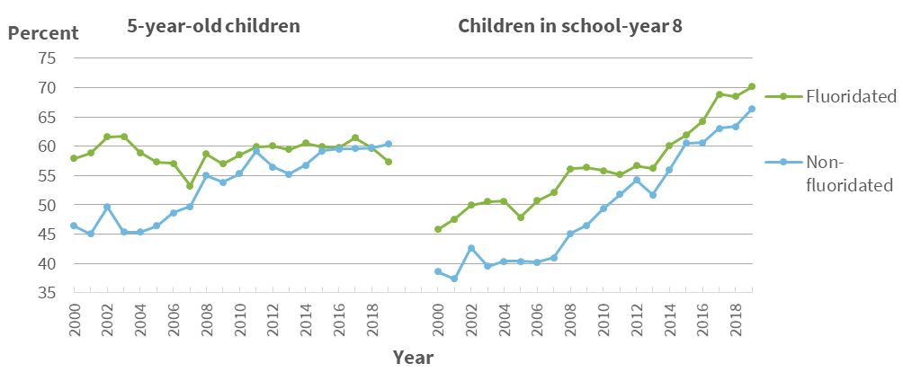
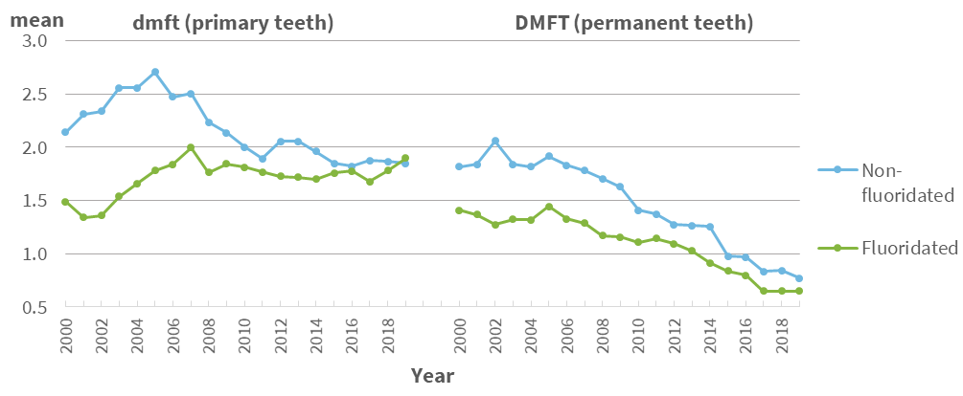
Children’s oral health
Gain in caries free percentage for fluoridated 5y.o. shrank from +12% to -3%.
The advantage for children in school-year 8 went from +7% to +4%
Reduction in mean dmft for fluoridated 5y.o. went from 0.7 fewer decayed/missing/filled teeth to >0.1.
For children in school-year 8, the difference in mean DMFT went from 0.4 to 0.1
Both measures for 5y.o. children have been mostly static since around 2008.

Slide 43
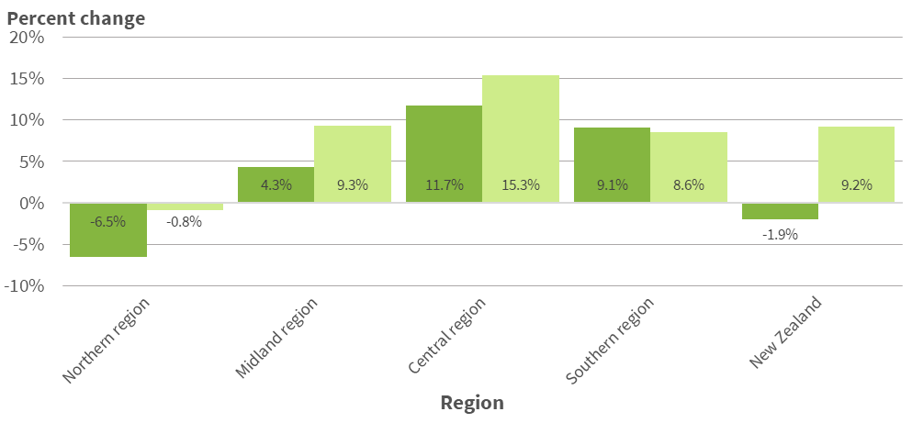
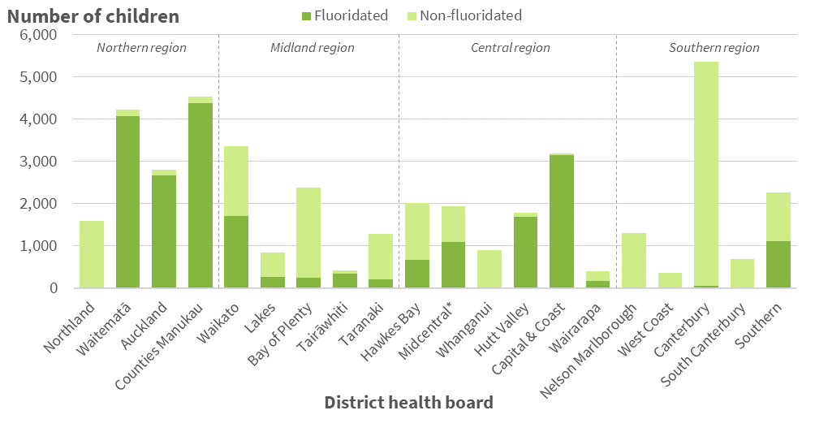
Children’s oral health – what’s going on here?
Being in the ‘Fluoridated’ group doesn’t guarantee access to fluoridated water
Decline in caries-free percentage only exists in the northern region
Three northern region DHBs supplied more than half the fluoridated population seen in 2019 – is this region cancelling out the improvements elsewhere?
Number of 5y.o. children seen also declining, especially in Waitematā, Auckland and Counties Manukau. Is under-resourcing or targeting of highest-need groups in these DHBs affecting the reported trend?

Slide 44
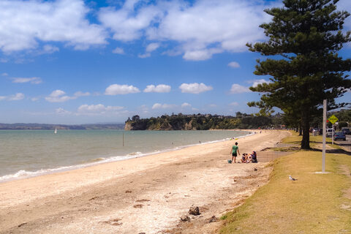


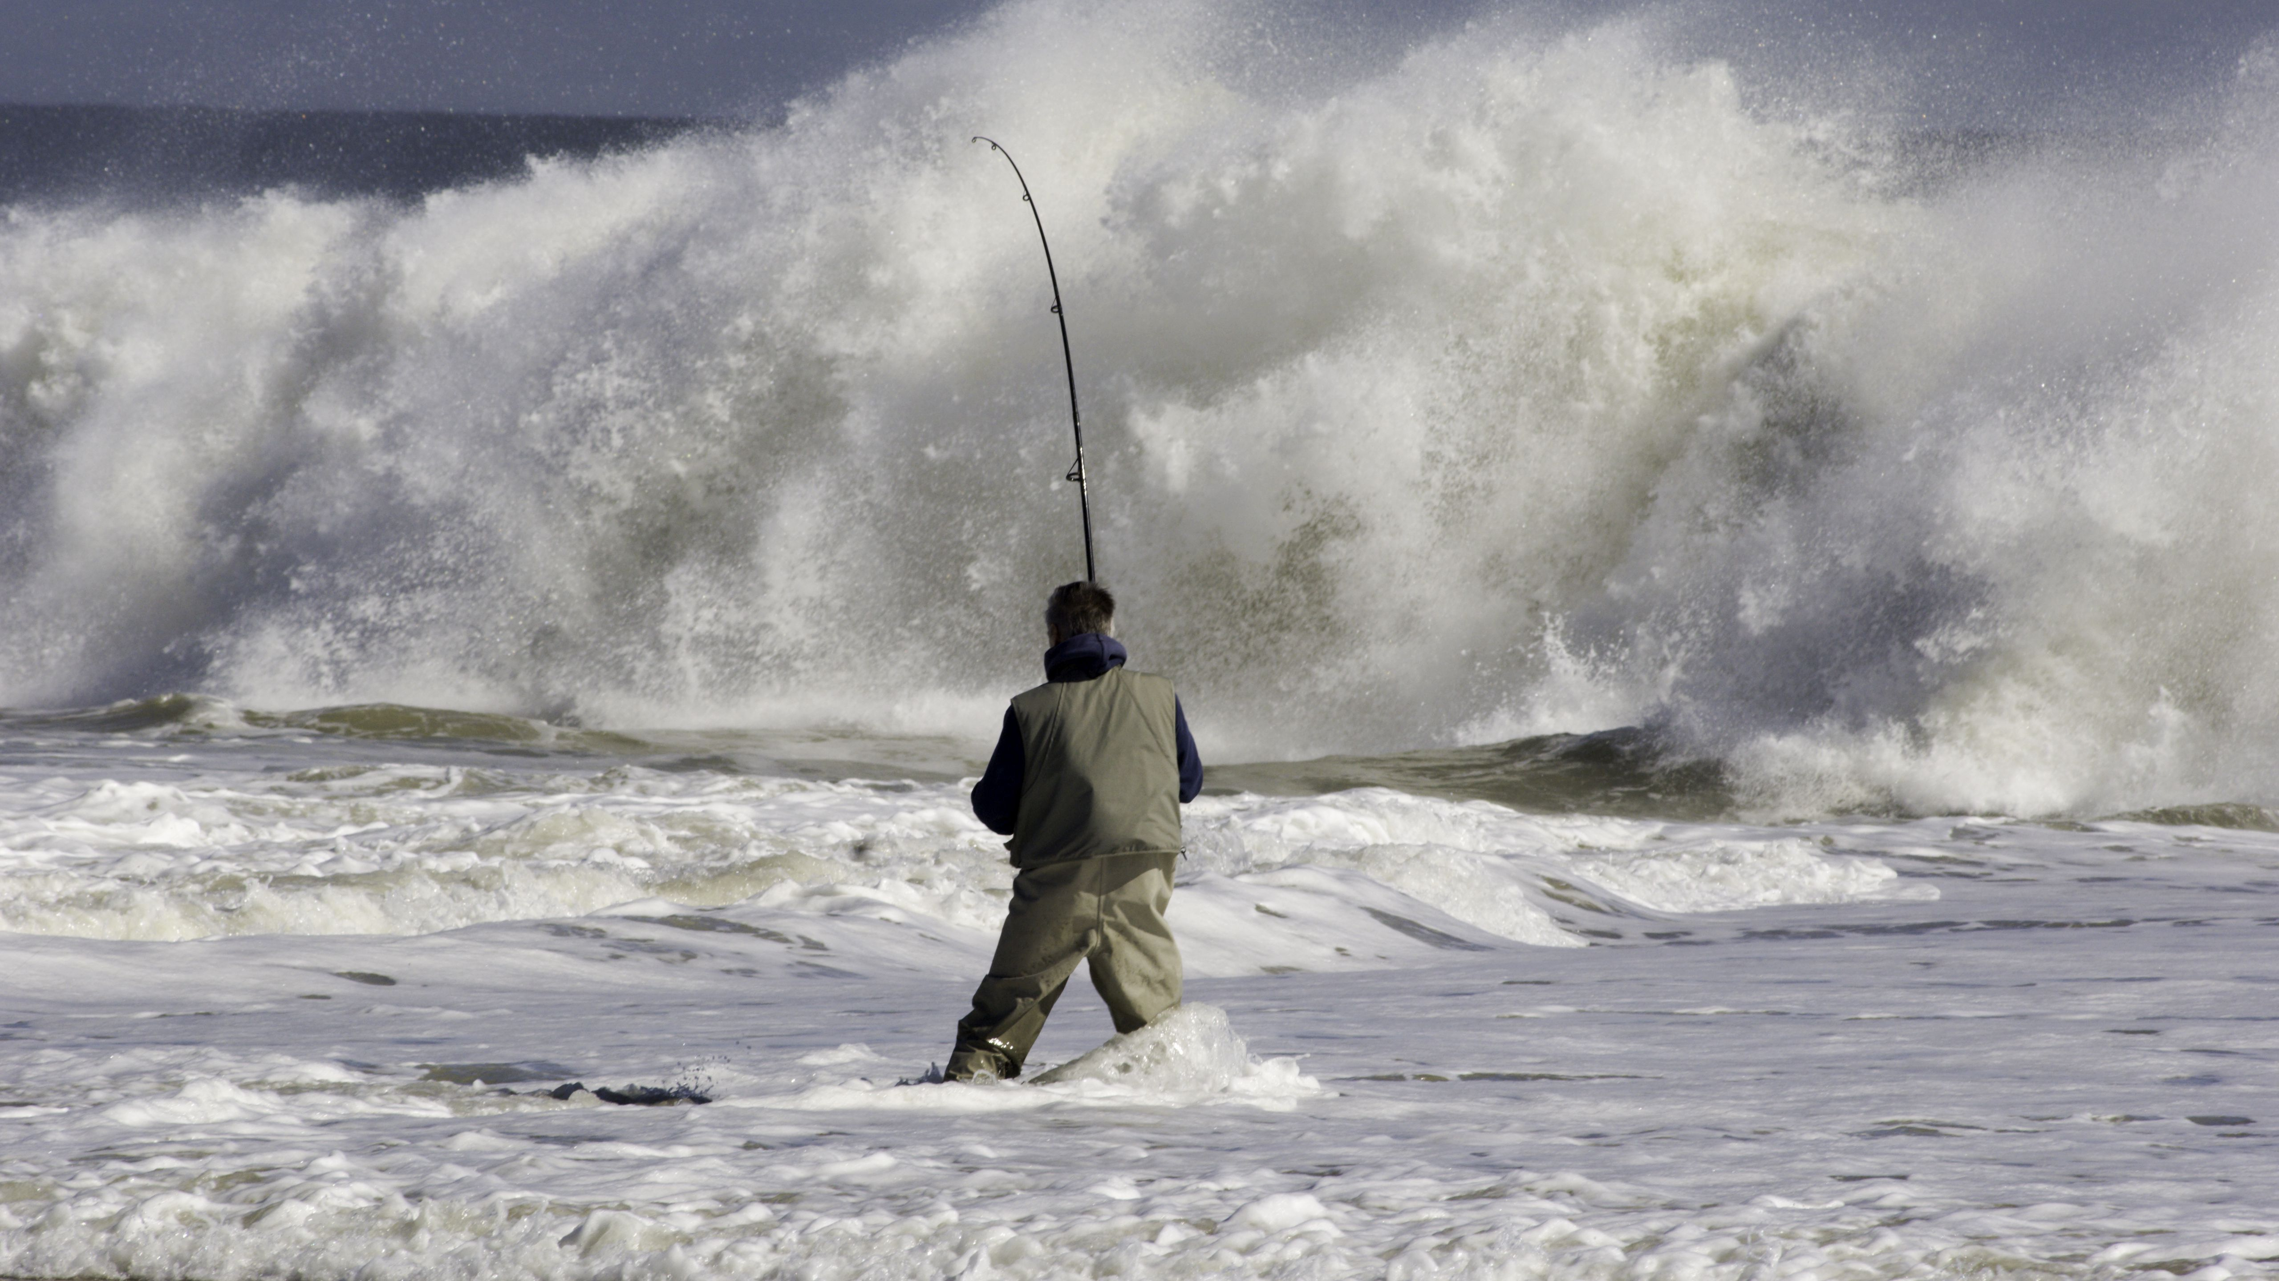
Water safety topic
Water Safety New Zealand estimates that annually there are:
Drownings are already covered by WSNZ.
Other injuries (fatal or not) are not as well reported.
Two new indicators drawn from NMDS and Mortality Collection are being prepared:
  Water transport injury
  Recreational water user injury
3.5 million visitors to the beach
4.5 million boating excursions
1.1 million recreational water users
700,000 people who go fishing

Slide 45
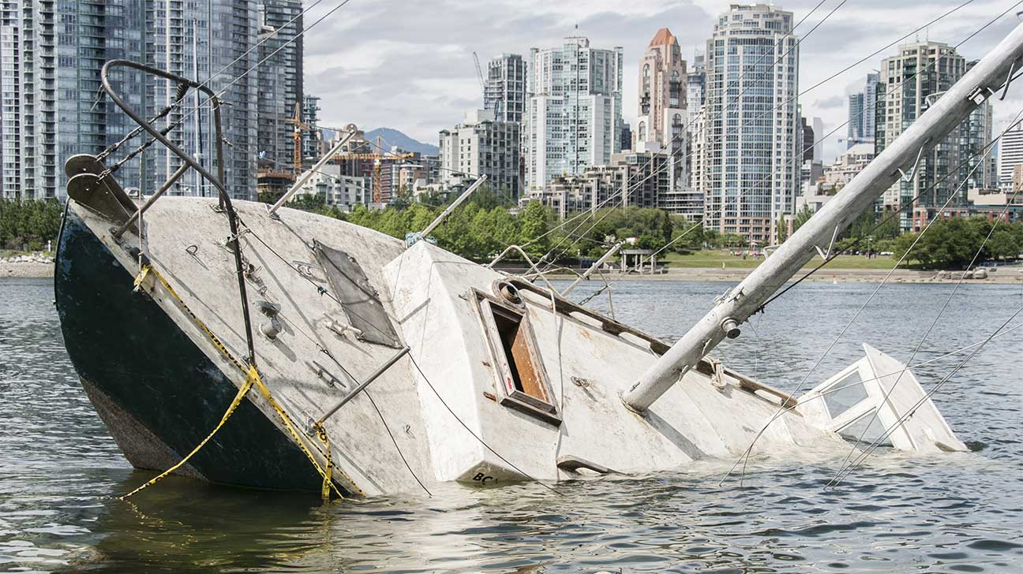

Water safety indicators
Water Transport Injury
Based on ICD Codes V90-94: Accidents to & onboard watercraft, causing injury, drowning or submersion
Will pair with the existing land transport injury / mortality indicator
Ready to go in early 2022
Recreational water user injury
Based on ICD Codes U52-54 (Water Sports), and others TBD
Reliance on ICD codes may miss certain injuries sustained in the water
More development work needed. And a snappier name.

Slide 46
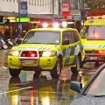
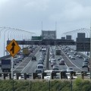

Transport & Travel

Slide 47
Indicators
Road traffic injury | Number of road traffic injury deaths / hospitalisations Overall In children (0-14yrs)
Household travel time | Average hours per year spent travelling by specific modes of transport
Main mode of transport to work | Average hours per year spent travelling to work by specific modes of transport Number of people using specific modes of transport to travel to work on Census day
Active transport to & from school | Percent of children (ages 5-14) who regularly use active transport to and from school
Unmet need for GP services due to lack of transport | Estimated percent of people who were unable to access GP services as they lacked any form of transport to get there
Motor vehicles (shared with Air Quality) | Number of motor vehicles Average age of motor vehicles
Short description section
  Body copy.
    Note
Bullet points
Bullet point

Slide 48
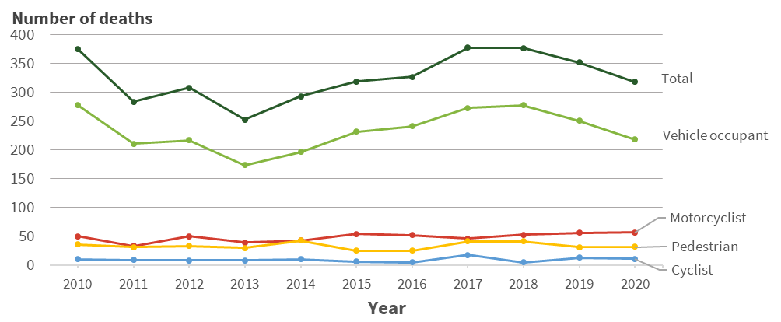
What’s new?
2020 Road toll: lower than 2019, but how much is due to effects of Covid-19?
Percent change 2018-19: -7% (25 fewer deaths)
Percent change 2019-20: -11% (34 fewer deaths)
Decline only in vehicle occupant mortality, minimal change (+/- 1–2 deaths) in all other classes.
Drop in occupant mortality not noticeably larger than in previous year.

Slide 49
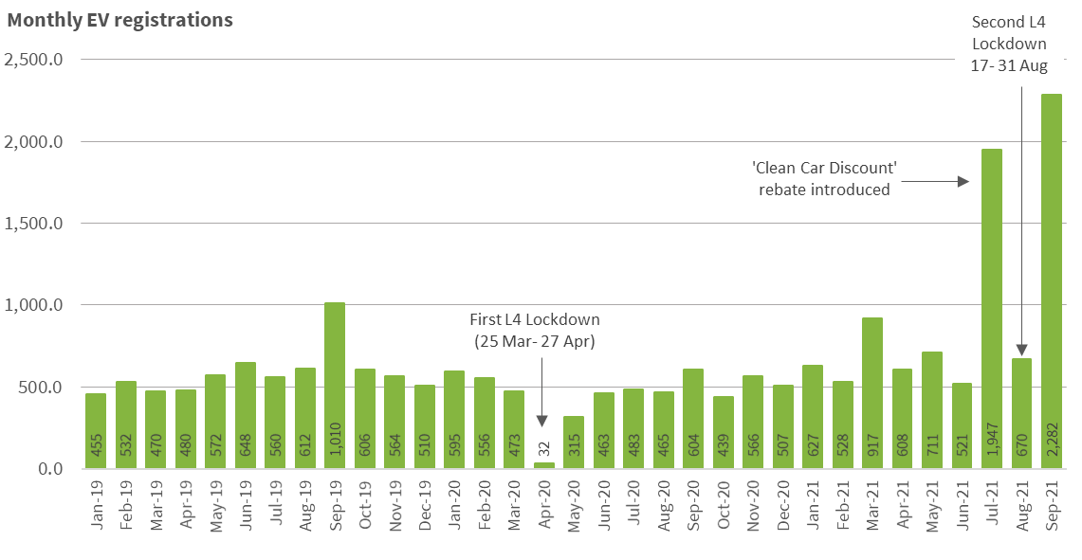
What’s new?
Strong gains in EV registrations following introduction of rebate scheme
First month of EV rebate scheme saw a fourfold increase in EV registrations.
Covid-19 does not appear to have affected EV registrations – aside from during Lv. 4 lockdowns.

Slide 50
What’s next?
Predicting & reporting the impact of Covid-19 on transport indicators
Cycle of data releases means it may take 1-2 years for effects of lockdowns & travel restrictions to show up in indicators
Indicator | What might happen?
Household travel time | Prevalence of private vehicle use could increase in response to reductions in public transport services, or public health regulations imposed on these. On the other hand, total time spent travelling is likely to decrease.
Main mode of transport to work | Might see private vehicle use climb – but how will the uptake of WFH culture affect commuting habits?
Active transport to/from school | How will school closures/shifts to online learning affect this? Will shifts in public transport drive more people to active transport – or to private vehicles? Parent’s commuting habit may also come into play
Unmet need for GP services | Expect unmet need to increase owing to fewer public transport options and inability to get lifts from people outside the patient’s bubble

Slide 51

Q& A
Water & transport Q & A

Slide 52

Border health in new Zealand
Stakeholder Presentation

Slide 53
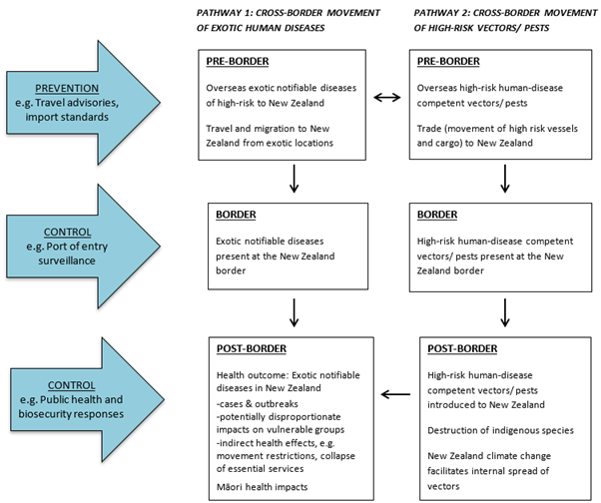
Current Domains
4 indicators covering NZ Border Health
Mosquito-borne disease in New Zealand (Formerly “Border Health in New Zealand”)
2019 data
Overseas infectious diseases of priority concern.
2021 data
Exotic mosquito species established in NZ
2020 data
High-risk pests caught at the New Zealand border
2020 data
Border health in new Zealand

Slide 54
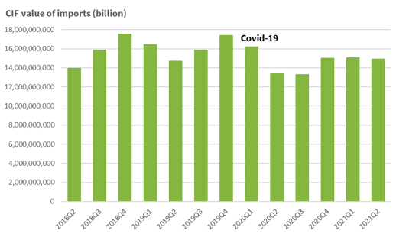
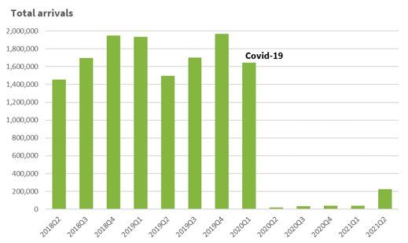
Covid-19
Imports
Changes due to Covid:
Imports remain relatively stable
International travel has decreased by 98%
Covid is the first PHEIC to enter NZ since 2009 (swine flu).
International Travel
Border health in new Zealand

Slide 55
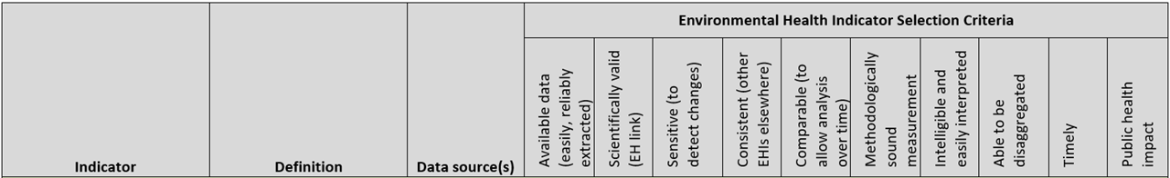
Border Health Domain Review
Covid will not be the primary focus of the domain (MoH, StatsNZ & ESR all cover the topic in detail).
Evaluation of StatsNZ travel data.
Determine the scope of the domain
What are the priority diseases at New Zealand's border?
Currently exotic mosquito borne, respiratory and PHEIC diseases
What data sources are available internationally (especially in the Asia-Pacific)?
Border health in new Zealand

Slide 56
Crossover with EHI Domains
Climate Change: ​
​
Projected migration of mosquitoes in NZ.​
Climate conditions suitable for both mosquito breading and viral propagation.
Social Vulnerabilities:
Impact of crowded housing on disease spread​
​
Impact deprivation has on individuals abilities to respond to outbreaks​
Risks related to New Zealand's aging population
Border health in new Zealand

Slide 57
If you have any questions about the domain, please feel free to contact us:
Email: Lkelly1@massey.ac.nz
EHI Email: ehinz@massey.ac.nz
Presented by Liam Kelly
03/11/2021

Slide 58

UV Exposure Domain
Stakeholder Presentation

Slide 59
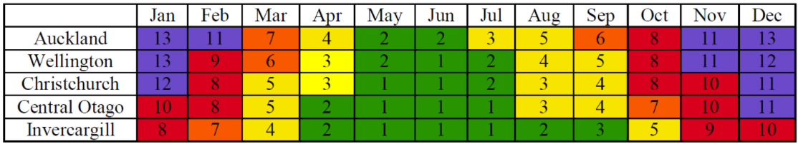
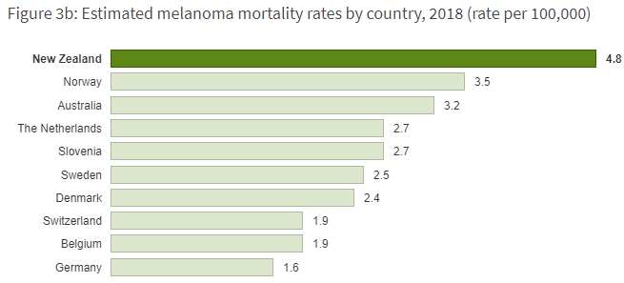
Current domains
4 indicators covering UV and its impact on health in NZ
UV Levels
Melanoma (which covers both registrations and mortality)
Non-Melanoma Skin Cancer Mortality
Vitamin-D Deficiency
UV Exposure Domain

Slide 60
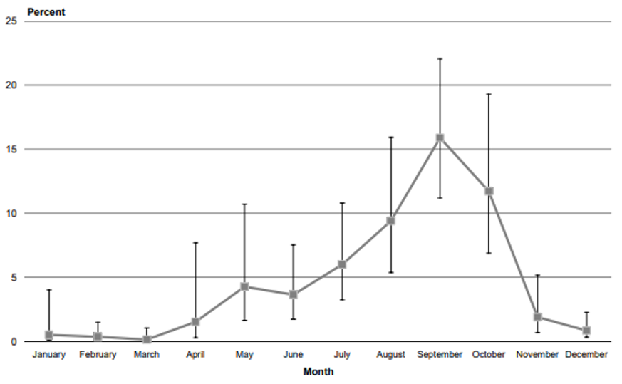
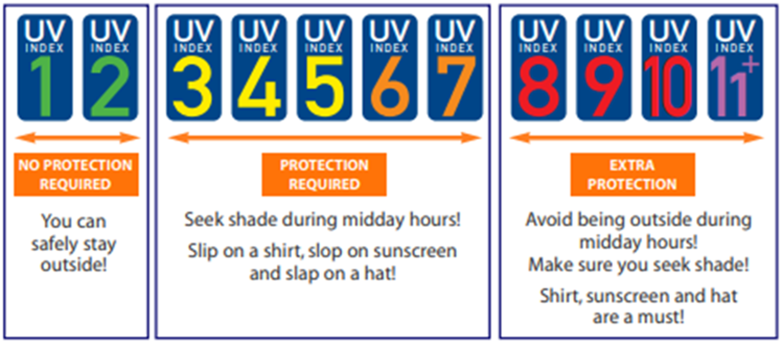
Future interests
Estimated proportion of NZ deficient in 2008/09
Vitamin D:
Current data from 2008/09 adult nutrition survey.
Estimates made for population based on 3099 blood samples taken across NZ.
If/when new data becomes available a factsheet may be produced.
UV Index:
Past presentations have used NIWA graphics to illustrate levels by time for different parts of the country.
Potential to map changes in a similar way to climate change if data is available.
Potential to link to climate change models in the future.
SunSmart promotional material
UV Exposure Domain

Slide 61
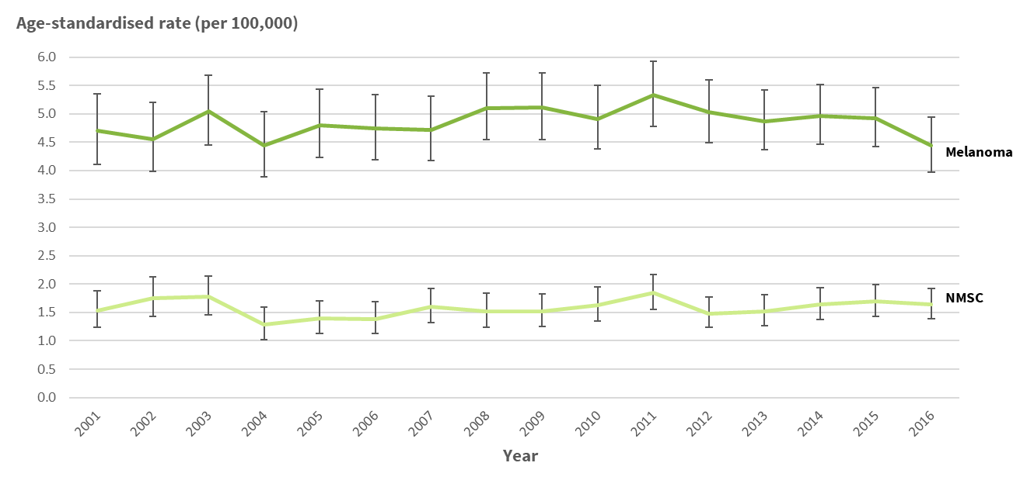
Future interests
We have tracked skin cancer from 2001 onwards using MoH mortality data.
Potential to look at rates of other disorders such as cataracts. However that is dependent on the data available.
Both NMSC and melanoma mortality factsheets and data will be updated to 2018 data in the coming weeks
UV Exposure Domain

Slide 62
Thank you for coming to the UV domain presentation, if there are any questions please feel free to email or call:
Email: Lkelly1@massey.ac.nz
EHI Email: ehinz@massey.ac.nz
Presented by Liam Kelly
03/11/2021

Slide 63
ALCOHOL-RELATED HARM
Kirstin Lindberg, Principal Analyst
k.lindberg@massey.ac.nz

Slide 64
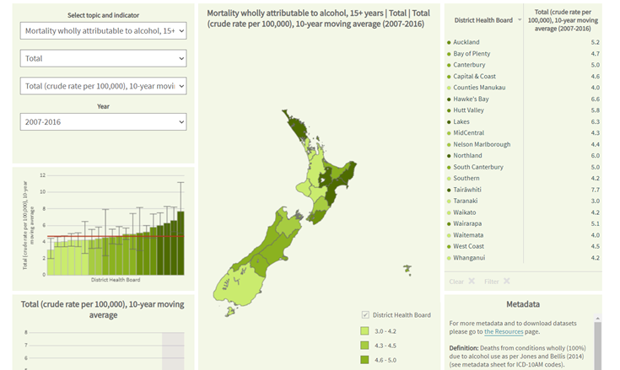
Current indicators
Harms
  Hospitalisations wholly attributable to alcohol
  Mortality wholly attributable to alcohol *
  Alcohol-related crashes – ON HOLD
Alcohol use
  Hazardous drinking
  Heavy episodic drinking*
Alcohol environment
  Alcohol licence outlet density
Alcohol-related harm indicators

Slide 65
Alcohol outlet LICENCE density – Access & availability
Updating with Dec 2019 data (pre-COVID19)
Can also produce density per child (0-14 years)
  Form of advertising exposure to children
Prioritising urban areas for analysis
Additional outputs
  Maps on request, natural breaks
  Spatial clustering in urban areas, heat map
Alcohol-related harm indicators

Slide 66
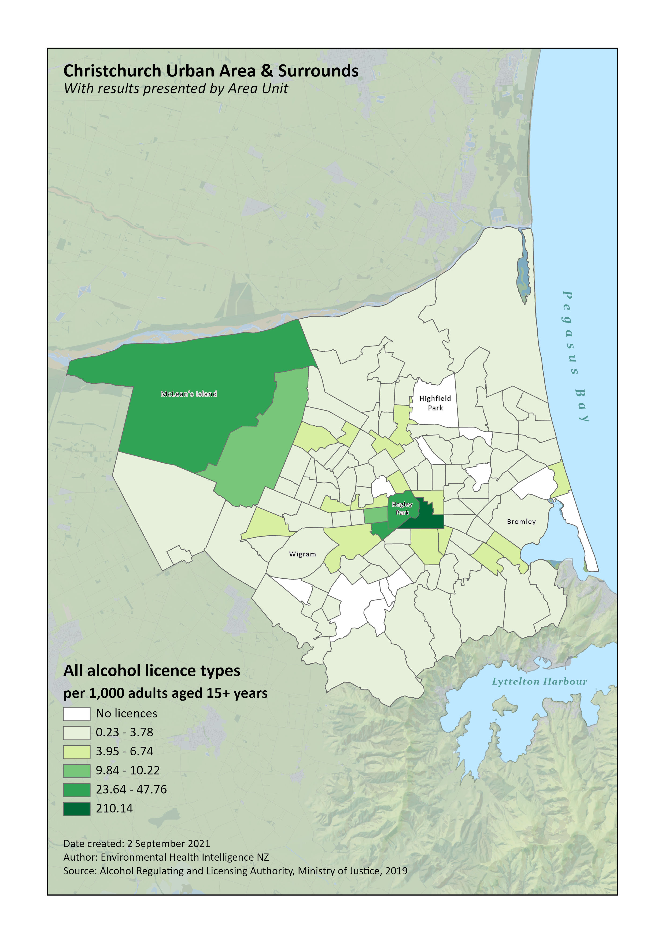

Alcohol outlet licence density- Examples
Alcohol-related harm indicators

Slide 67
Other ideas
Hospitalisations
  Review of ICD codes for hospitalisations (and mortality)
  2020 data results by month/quarter (COVID-19 impact)
  Present number of cardiovascular hosps for comparison (hosp for alcohol higher even just wholly attributable)
Future implementation
  Affordability (HPA work)
  Social supply of alcohol (HPA, Alcohol Use in NZ survey)
Alcohol available for consumption? (Proxy for sales during 2020, 2021)
HPA/University of Otago Wellington Burden of Disease
Alcohol-related harm indicators

Slide 68


Indoor environment
Helene Marsters (pre-recorded)

Slide 69






Indoor environment indicators
Exposure indicators
Household crowding
Home heating
Maternal smoking at two weeks postnatal
Second-hand smoke exposure in the home
Health indicators
Lower respiratory tract infection hospitalisations (0-4 years)
Sudden unexpected death in infancy
Asthma prevalence (medicated) (2-14 years)
Asthma hospitalisations (0-14 years)
Meningococcal disease notifications (0-14 years)
Indoor environment

Slide 70

Sudden unexpected death in infancy (sudi)
Indoor environment

Slide 71



Sudden unexpected death in infancy (sudi)

Slide 72

Sudden unexpected death in infancy (sudi)
What is driving the differences in SUDI rates?
maternal smoking
ethnicity
socioeconomic deprivation
age of mothers

Slide 73

Lower respiratory tract infection hospitalisations
How has COVID-19 lockdown measures impacted LRTI hospitalisations?
Indoor environment

Slide 74
Questions?
For more info, visit our websites:
www.ehinz.ac.nz
www.healthspace.ac.nz
or email:
Helene Marsters t.h.marsters@massey.ac.nz
EHINZ team ehinz@massey.ac.nz
Indoor environment

Slide 75
(Last Chance)
Q& A

Slide 76
Thanks for coming!
For more info, visit our websites:
www.ehinz.ac.nz
www.healthspace.ac.nz
Or email:
ehinz@massey.ac.nz
Copies of the presentation slides are available on request

