Slide 1
Opening up the ‘black-box’: what strategies do community mental health workers use to address social dimensions of mental health?
Kaaren Mathias, University of Canterbury and Burans, India
Sumeet Jain, University of Edinburgh, UK
Pooja Pillai, Herbertpur Christian Hospital, India
Annabel Ahuriri-Driscoll, University of Canterbury

Slide 2
Background
Globally a prominent but un-nuanced discourse on ‘task-shifting’.
Growing recognition in national mental health funding allocation to address psycho-social aspects of mental health e.g .Brief intervention across primary care in Aotearoa NZ/ peer support workers in ED.
Recent ethnographic literature recognises the ways that CHWs address social dynamics (c.f. Chase 2022, 2023; Lang, 2019; Kottai and Ranganathan, 2020)
How do CHWs innovate at a micro-level to promote social inclusion & recovery?
Notes:
The launch of the global mental health movement in a Lancet series in 2007, identified task-shifting as a key role of CHWs to address the shortage of professional human resources. Several studies have demonstrated the importance of community-based workers to promote mental health in communities (Chatterjee et al., 2014; Chatterjee, Patel, Chatterjee, & Weiss, 2003; Chatterjee, Pillai, Jain, Cohen, & Patel, 2009; Patel, Weiss, Chowdhury, Naik, & Pednekar, 2010) and particularly, in delivering psychosocial interventions, for example, in the Friendship Bench intervention where CHWs delivering a structured and locally accessible psychosocial intervention (Abas et al. 2016).
Yet while CHWs have been assigned responsibilities to enable mental health ‘task-shifting’ in multiple low- and middle-income countries, there are multiple challenges linked to this policy solution (Agyapong et al., 2015). These include mental health care responsibilities being added on to a long list of other health system responsibilities, a lack of supervision and training, poor remuneration, and the ongoing asymmetries of gender relations linked to CHWs being almost exclusively female in predominantly patriarchal settings (Agyapong et al. 2015; Mutamba et al., 2013).
Recent ethnographic literature seeks to unpack the social dynamics of CHWs roles in mental health. For example, both Lang (2019) and Kottai and Ranganthan (2020) examine the processes through which CHWs perpetuate medicalization in communities in different parts of Kerala, India. Chase (2023) working in Nepal, attempts to untangle the different roles (family members, neighbours, health worker) that that CHWs hold , arguing that the work of CHWs shifts the very nature of relatedness.

Slide 3
Research Question
What strategies do community health workers use to address the social dimensions of mental health?
Why use data from India and Aotearoa?
Notes:
How do CWs conceptualize outcomes – both positive and negative?
How do CWs conceptualize the determinants of poor mental health?

Slide 4
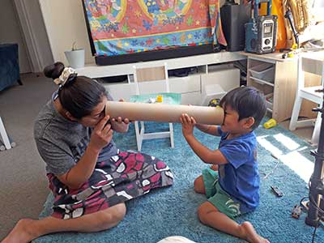
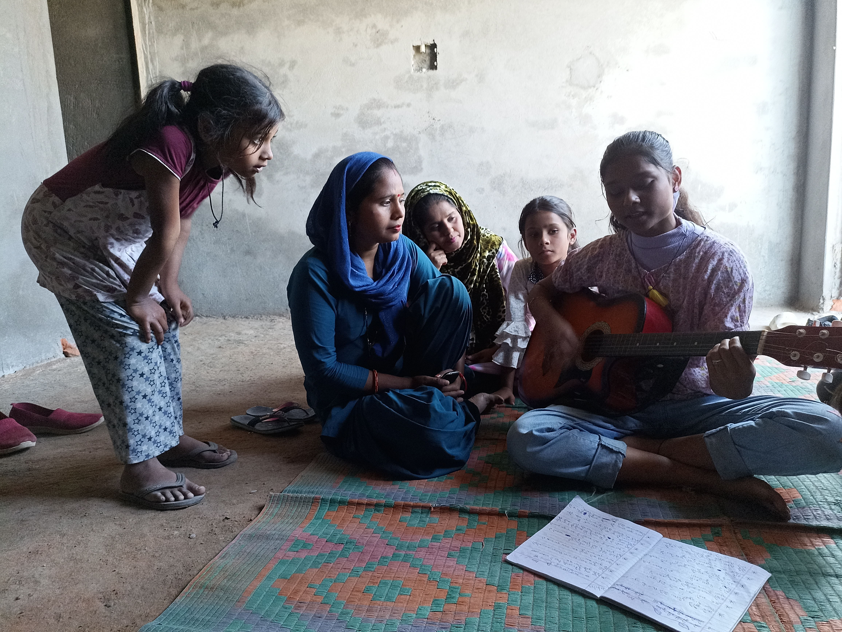
Setting – non-profit providers
AOTEAROA NEW ZEALAND Three organisations selected from 11 candidate ‘best practice’ child health providers
Te Puāwaitanga ki Ōtautahi Trust
Purapura Whetū
Early Start
INDIA One organisation – Burans – a non-profit community mental health provider in Uttarakhand

Slide 5
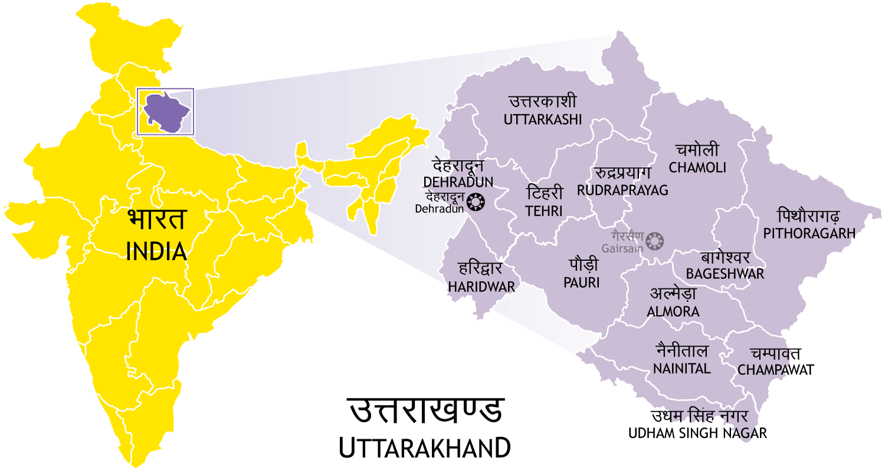
Contexts
Urban – Christchurch, New Zealand
Semi urban & rural – Uttarakhand, North India
Notes:
This study was set in bustling peri-urban settings of Dehradun, the capital city of the north Indian state of Uttarakhand. This sprawling periurban district has 1.96 million residents. The dominant patriarchy is evidenced in the sex ratio of 902 females born to every 1000 males while the national sex ratio is 940. Disadvantage for women is further evident in the disparate literacy rates which are 78% for women and 89% for men (Government of India Census, 2021).
It was hosted by Burans, a non-profit community mental health partnership project that started in 2014 (www.burans.org). The three geographical communities engaged in this study were: (1) Sahaspur, a town of 100,000 people living in closely co-located and informal brick housing; (2) Kanwali road, in the centre of Dehradun city, where 80,000 people lived in informal housing, lining a large open sewer; and (3) Mussoorie, a tourist town one hour’s drive from Dehradun, where a large service-industry supports hotels, with 35, 000 residents (insert map indicating these areas).

Slide 6
Kaimahi/ CHWs - Christchurch
Range of titles/ roles
Front facing with clients
Mix of regulated and unregulated

Slide 7
Community health workers - Dehradun
Main roles:
Identification and psychosocial support to people with mental distress
Awareness raising in community
Facilitating access to biomedical care if wanted/ needed
Networking with key leaders, eg govt health workers

Slide 8
Methods
16 interviews (service leadership, whānau, kaimahi) - Christchurch
46 interviews (community health workers) - Dehradun
Interviews addressed: What were social determinants; CHW’s understanding of client’s problems; work they undertook with clients; what changed for the client and why; and challenges/barriers
Open inductive coding with two coders to agree a broad coding scheme.
Qualitative content analysis
Notes:
In the second half of 2017, PP and KM interviewed CHWs about their PPSD clients using a semi-structured interview format that probed their understand of client’s problems, their engagement and responses to PPSD and barriers they faced. Interviews were conducted in Hindi, audio-recorded and detailed notes were made from recordings and translated into English.
KM and PP as employees in the same organisation as the CHWs also spent several weeks shadowing the CHWs while they went about their work in the community. They sat in on conversations, watched how CHWs interacted and built connections and took written notes describing their observations of CHWs working with PPSD. They also read and reviewed the hand-written care plan records that were kept by CHWs after each home-based visit. The information collected in these care plans is described in greater detail in two published studies (Mathias et al., 2018; Mathias et al., 2021).
Analysis of data used a case study analysis approach, considering each CHW as a case study. Interview data was coded emergently by KM and SJ, paying attention in particularly to the strategies used by CHWs and the ways that they identified and engaged with social and structural determinants of mental health.
Limitations were the interviewers (PP and KM) did not speak the dialect of the communities where PPSD and community workers were based, which may have limited understanding of the context. Additionally, some of the interviews risked social desirability bias as both interviewers were also involved in project operations and they may have been perceived as providing access to resources. The positive aspect of project implementation team members participating in data collection is that they had a strong understanding of the structural factors that contribute to mental health problems and had many interactions and observations of PPSD which could contribute to and enrich to their analysis of data.

Slide 9
FINDING ONE
Deep knowledge of context and social factors core to social interventions
“Deepak is a single 20 year old man from the Sikh community. He dropped out of school after Class 1 as his family was migrating for work between Dehradun and Lucknow. That disrupted his education. He actually tried and re-did his first grade several times but eventually he lost interest. So in his early teens, he started on an apprenticeship. However his uncle and father went to prison in his mid-teens, now he does any kind of mazdhuri (daily labouring) work. So he really doubts himself and ability to connect with peers…
but he was happy to join youth resilience group. It made all the difference”
Notes:
In this study we identified particular constellations of the skills and strategies that CHWs use to engage with the ‘social’ of mental health.
These include (1) deep knowledge of context and social factors impacting people with psychosocial disability which informs action on social and structural determinants of healthand (2) relationships and relationality which supports outcomes and (3) Delivery of tailored and bespoke care with micro-adaptations linked to their knowledge of the PPSD and family dynamics. These three factors mean that CHWs are able to address social mental health in diverse and bespoke ways that are adapted to the specific contexts of the lives of the families and individuals with which they work .

Slide 10
TWO
Relationships and relationality a springboard which all other outcomes and social interventions bounced froms – including value of shared experiences
I mean they share a bit about their family experiences as well, you know. So you get to, you kind of get that, they’re kaimahi, but they’re also family members, mothers, and, you know, sisters or grandparents and things like that () but it’s just kind of real. ( ) That’s quite, quite a good, good way to break through those kind of walls.
Mother, Purapura Whetū (Te Oriori)

Slide 11
TWO When whānau and kaimahi shared their life experiences with each other, they formed a trusting relationship which felt supportive and could then take active steps for their future
Mostly because he’s probably been through the same stuff so I’ll ask him how did you manage to make it through, manage to cope with whatever was happening.
Young person, Purapura Whetū

Slide 12
THREE
Delivery of bespoke care with micro-adaptations linked to their knowledge of the person with mental distress and family dynamics.

Slide 13
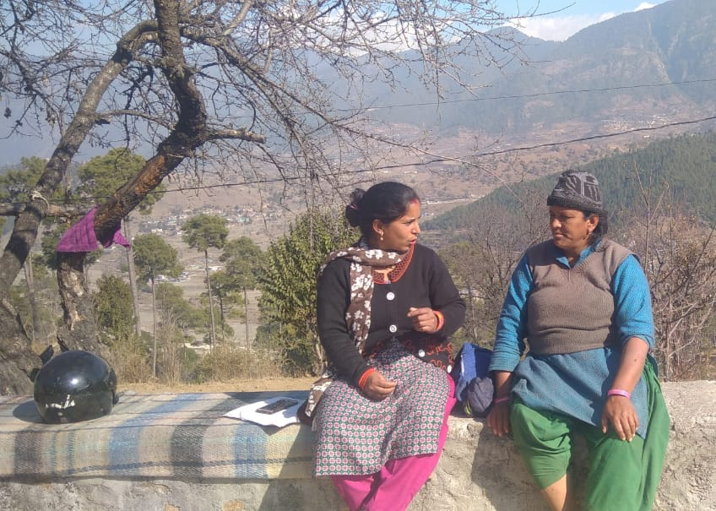
USING ALL THREE Contextual knowledge, relationships and bespoke adapations
“She didn’t want to go to the doctor with us for the first few months, so we suggested she starts with very easy social connections e.g. the people right next door and talk about how they are and then as she got more confident she talked to those further away. “
Notes:
CWs used their in-depth knowledge of clients’ mental health status, family dynamics and other contextual factors to adapt and implement micro-interventions in a bespoke way:

Slide 14
Concluding points
Relationality
Tailored care - cultural and contextual adaptation
Engaging with social and structural determinants of mental health
Notes:
Relationality and outcomes
The strong relationships between CHWs and PPSD emerged from this study as a key mechanism supporting outcomes. Positive relationships have been identified as core to mental health recovery. Recently theorised approaches to relational care in health services suggest that relationships can have causal effects when enabled by the following conditions: firstly, each person has a personal and social identity known to the other. The fact that CHWs are well known and live in or near to the communities they work mean that they are known and can use their personal experiences to facilitate the relationship (Leamy et al, 2011 ). Chase (2023) drawing on ethnographic research in Nepal explores what happens in the context of task-shifting when the boundaries between CHWs and community members are fluid .
Secondly, relational care is primarily characterised by caring rather than a focus on activity or performance (outputs and outcomes). This was evident in this study, for example, when the CHW describes Sanjay feeling affirmed due to the relationship rather than perceiving the relationship as transactional or conditional on performance. Thirdly, CHWs described how trust grew with growing duration of the relationship, as described in the example with Sanjay, the village leader with alcohol use problems.
Bring in Chase's points about the problems of relationality.
See Chase's point about informal and professionalized approaches - and how later might lead to better outcomes for most marginalized
Can link to the point made in Kottai about coercion.
Tailored care and cultural and contextual adaptation
This study illustrates examples of ways that CHWs offer care explicitly tailored to local contexts. Evidence-based practices developed in one place are often not appropriate, feasible or effective in a different context (Kirmayer and Pedersen 2014). A large number of recent publications have identified the importance of a socially and culturally informed approach to community mental health that engages with the local context to develop endogenous solutions (Bemme and D’Souza 2014; Kirmayer and Pedersen, 2014). Chase (2021) discusses this in relation to lay psychosocial counsellors in Nepal. She illustrates how these workers creatively and flexibly use the concept of ‘psychosocial’ in their practice. For example, she discusses how CHWs developed symptom lists and descriptions that were flexibly tailored to social contexts and individual histories. This was in contrast to publicly available materials describing complaints that psychosocial counsellors could address.
Engaging with social and structural determinants of mental health
CHWs in this study described a way they supported PPSD was to support families and communities to act on structural health determinants such as access to clean drinking water and sanitation, building on their in-depth knowledge of the context as well as skills in accessing government entitlements. A recent scoping review (Ahmed et al., 2021) examined how CHWs can increase equitable health outcomes in LMIC, through advocacy for social and structural transformation. This study also found that CHW in particular gave additional time and resources to families who were most disadvantaged, recognising that they had fewer resources and supports. This approach was identified as a further key pro-equity strategy identified as CHWs focusing their efforts and attention on the families most disadvantaged, suggesting that that CHWs were more successful in increasing equity in service delivery than in health outcomes, a feature that we did not examine in this study.
One of the counter-arguments to the approaches that engage with the ‘social’ outlined above is that these bespoke approaches do not entirely materialize just from the CHWs and their interactions. They are likely to be linked to the ‘altruistic personalities’ described in Allen et al (1983) among individual CHWs who may be more likely to be compassionate, pro-social and socially connected than other community members. The values, shaped through the training and ethos of the host organisation are also likely to inform what CHWs do and how they do it (Kok et al 2015). There is additionally, something that happens in the interactions with PPSD that might be adaptive or bespoke. One potential way of looking at this is to conceptualize the approaches in terms of ‘thickness’ of interactions, and a layering process that takes place with different elements playing roles in a bricolage way. Additional methods which include ethnography are likely to be required to untangle and understand in-depth how CHWs develop contextualised micro-adaptations that support improved mental health outcomes among PPSD
The micro-innovations shown by CHWs in this study are non-linear and thus dependent on elements we have identified above including local knowledge, time; and relationships. A recent review showed that additional to health system and economic factors, the key community-level factors that influenced CHW performance and operations included socio-cultural factors such as gender norms and values, perceived safety and security as well as the education and knowledge level of the target group (Kok et al 2015). In considering which of these elements could be scaled, and how in thinking about social interventions, further attentive qualitative research is needed to examine in greater depth the particular interventions or particular ways of being employed by community health workers.

Slide 15
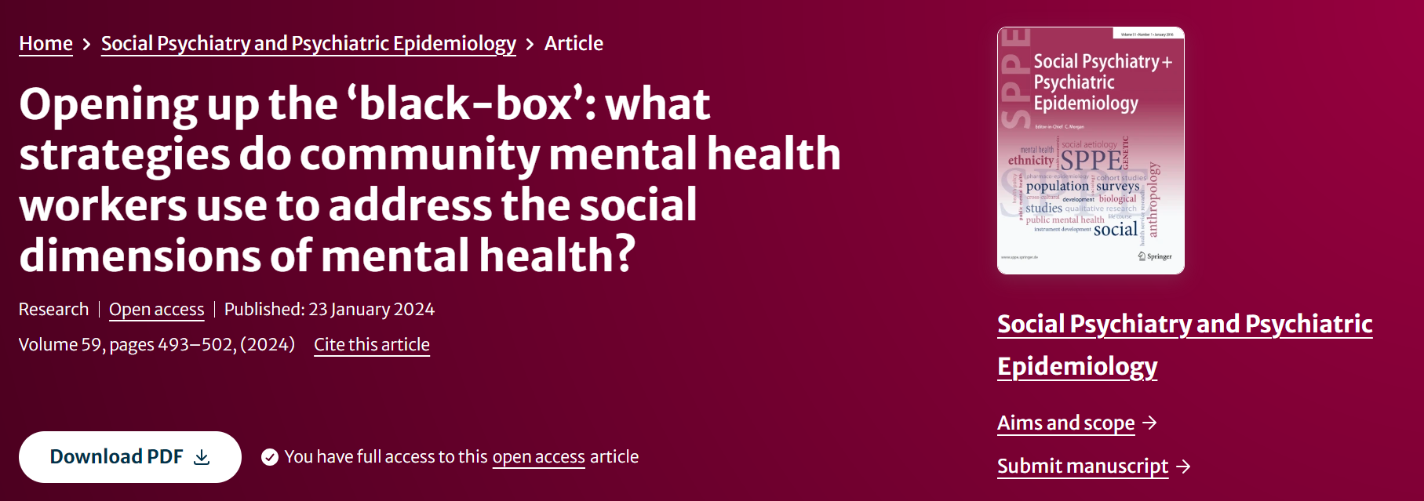
Acknowledgements
Funding:
Child Wellbeing Research Institute, University of Canterbury (AOTEAROA)
ESRC, University of Edinburgh (INDIA)
Research assistants: Dr Helen Mataiti, Lisabet Morgan
Kaaren.mathias@canterbury.ac.nz

